Slide 1
Courses @ NECST
Xilinx Vivado HLS
18/01/2018
Lorenzo Di Tucci <lorenzo.ditucci@polimi.it>
Emanuele Del Sozzo <emanuele.delsozzo@polimi.it>
Marco D. Santambrogio <marco.santambrogio@polimi.it>

Slide 2
Agenda
Introduction to the Hardware Design Flow
Vivado HLS:
Design Flow
Kernel Creation
Communication Infrastructure
Kernel Optimizations
Hands-On Example

Slide 3
Installation Party
Use this Google Doc to provide your data
https://goo.gl/FRCG6y
First, install the VPN we have provided you.
(Mac: Tunnelblick - Windows/Linux: OpenVPN)
To SSH to the machine:
ssh <name>.<surname>@nags31.local.necst.it
password: user

Slide 4
Installation Party
You can change your password here:
http://changepassword.local.necst.it/
You can also RDP to the instance using
Microsoft Remote Desktop (Microsoft/Mac OS)
Remmina (Linux)
To connect to the machine, or change your password you must have started the VPN.

Slide 5
Hardware Design Flow for HPC
Hardware Design Flow (HDF): process to realize a hardware module
HDF for FPGAs can be seen as a 2 step process
High
Level Code
High Level Synthesis
From High level code to Hardware Description Language (HDL)
System Level Design
Implementation on board
FPGA

Slide 6
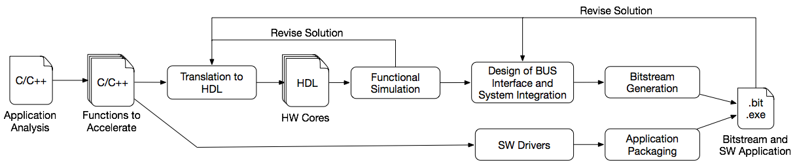
The Hardware Design Flow

Slide 7
The Hardware Design Flow
CAD tools aims at alleviating the design on FPGA

Slide 8
The Hardware Design Flow
CAD tools aims at alleviating the design on FPGA
Designer still need to manually perform system integration, driver generation and runtime management

Slide 9
The Hardware Design Flow
CAD tools aims at alleviating the design on FPGA
Designer still need to manually perform system integration, driver generation and runtime management

Slide 10

The Hardware Design Flow
CAD tools aims at alleviating the design on FPGA
Designer still need to manually perform system integration, driver generation and runtime management

Slide 11
Vivado HLS
High Level Synthesis tools
provided a high level description of a kernel, allows to generate a HDL of the application
increase the level of abstraction to ease the designing process
provides multiple hardware optimized libraries and APIs
directives driven architecture-aware synthesis

Slide 12
Vivado HLS Flow
C/C++
Possibility to specify the kernel using High Level Code
code must be refactored as a subset of C/C++ is supported
no dynamic memory allocation
Multiple API provided (arbitrary precision, mathematical functions, video library, etc..)
Possibility to specify a constraint file (clock uncertainty, clock period, target board)

Slide 13
Vivado HLS Flow
C/C++
IP Core Design and Optimization
Directives driven design and optimization
necessary to specify interconnection with memory (AXI4, AXI4Lite, AXI4-Stream)
The designer still needs to have clear in mind what architecture to implement

Slide 14
Vivado HLS Flow
Software Emulation
C/C++
IP Core Design and Optimization
Hardware Emulation
2 levels of emulation
Software Emulation used to check functional correctness of the application - does not guarantee correctness on the FPGA
Hardware Emulation check the correctness of the logic generated by the synthesizer

Slide 15
Vivado HLS Flow
Software Emulation
C/C++
IP Core Design and Optimization
IP Core Generation
Hardware Emulation
Eventually, IP Core can be generated and exported so that it can be used for the System Level Design Step.
At each step of the pipeline, it is possible to come back to the optimization phase

Slide 16
Kernel Creation
Not all the parts of an algorithm are suitable for hardware acceleration
First, it is necessary to profile the application to identify the bottlenecks of the application, i.e. the most compute intensive parts/kernels
Then, it is possible to start adapting and optimizing the kernels for the High Level Synthesis process
define the communication infrastructure
build the kernel architecture

Slide 17
Communication Infrastructure
Mainly, 3 types of communication may be implemented using AXI4 protocol:
AXI-Lite (for control signals)
Axi-Stream (to stream data)
Axi-Master (direct connection with the memory)
Vivado HLS provides directives to specify which type of communication to implement
However, the user has to develop the data transfer in an efficient way

Slide 18
Kernel Optimizations
Vivado HLS provides directives to optimize the kernel
The directives may refer to:
how to carry out the computation
loop pipelining/unrolling
function inlining
dataflow
resources to use for a certain computation
how to store the data on FPGA memory
array partitioning (block, cyclic, complete)

Slide 19
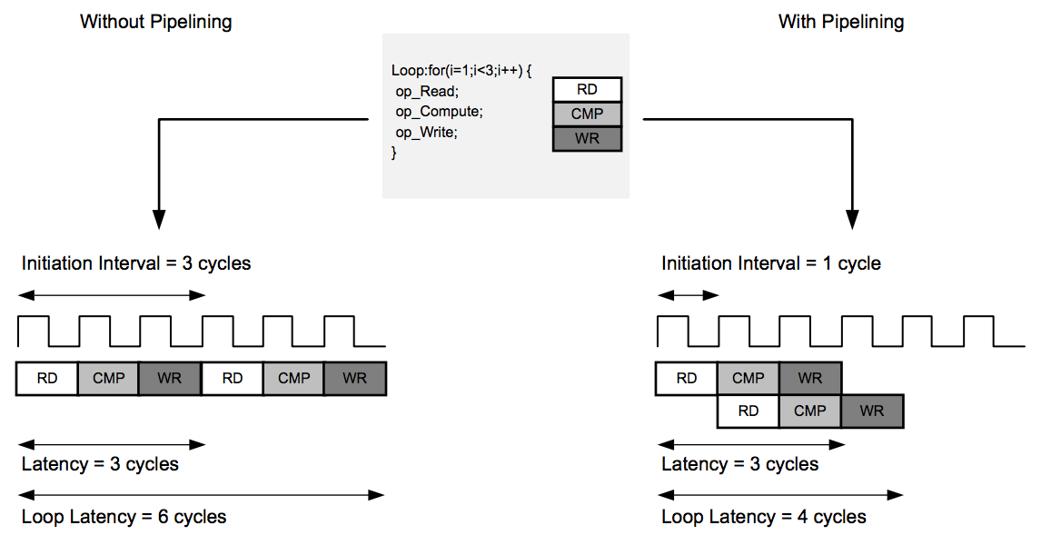
Loop Pipelining
Text

Slide 20
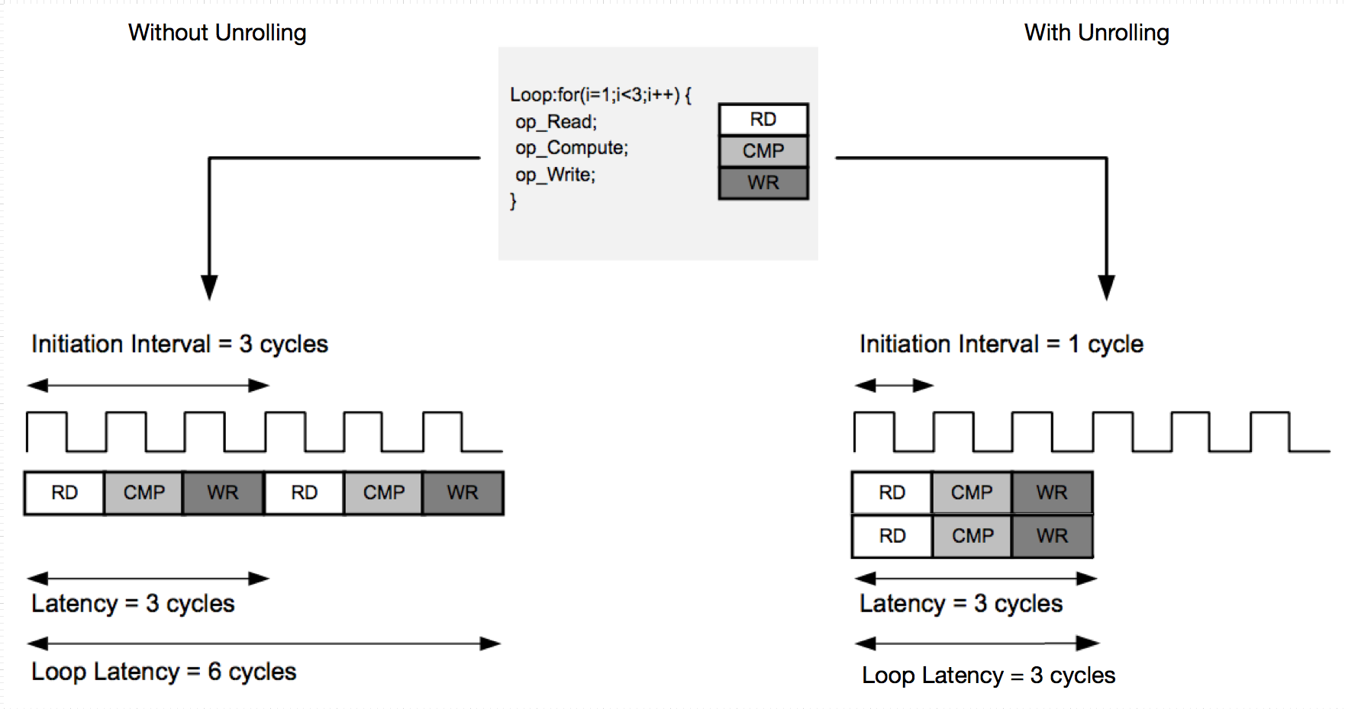
Loop Unrolling
Text

Slide 21
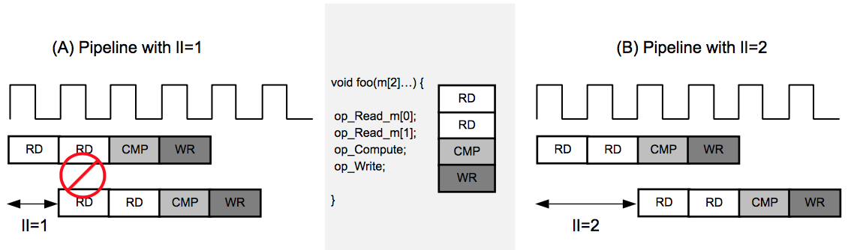
Resource Contention

Slide 22
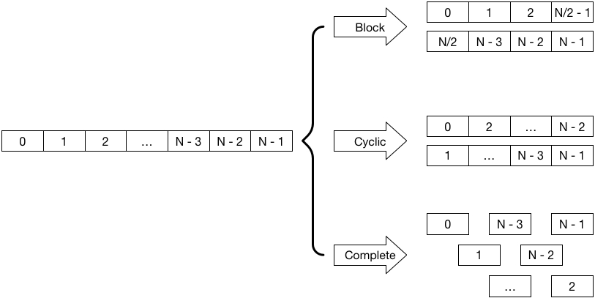
Array Partitioning

Slide 23
Example
Now we are going to see how to implement a vector addition of this form:
a = b + c*d
where a, b, c are vectors, and d is a constant
We will go through all optimization steps with Vivado HLS, from the project creation to the IP core generation

Slide 24
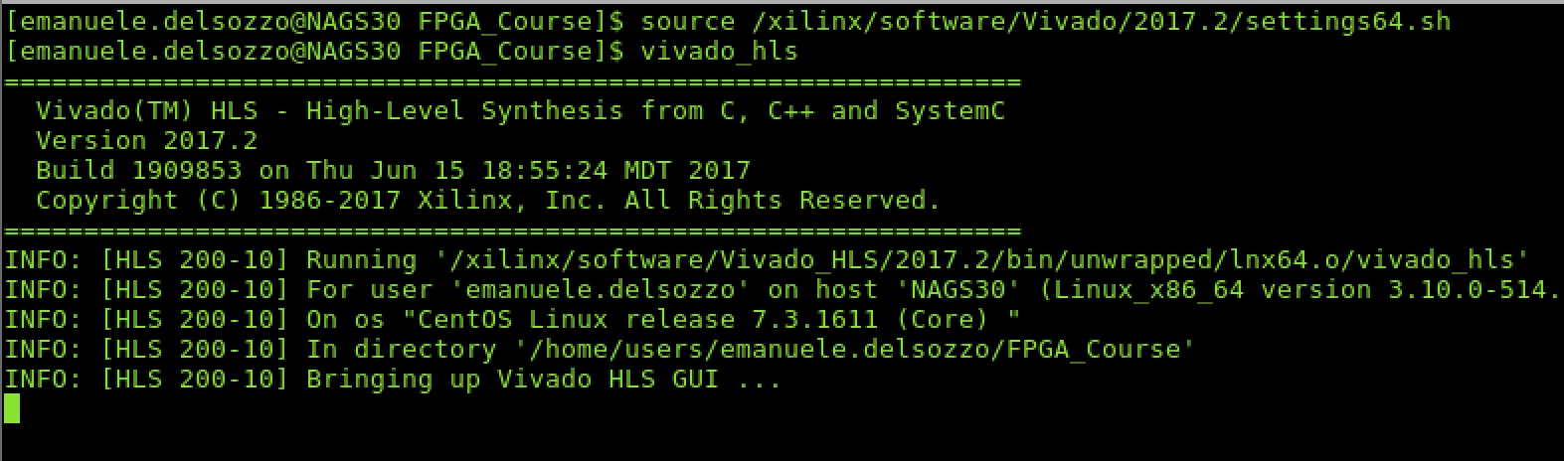
Launch Vivado HLS
Source settings64.sh in Vivado folder, then run Vivado HLS

Slide 25
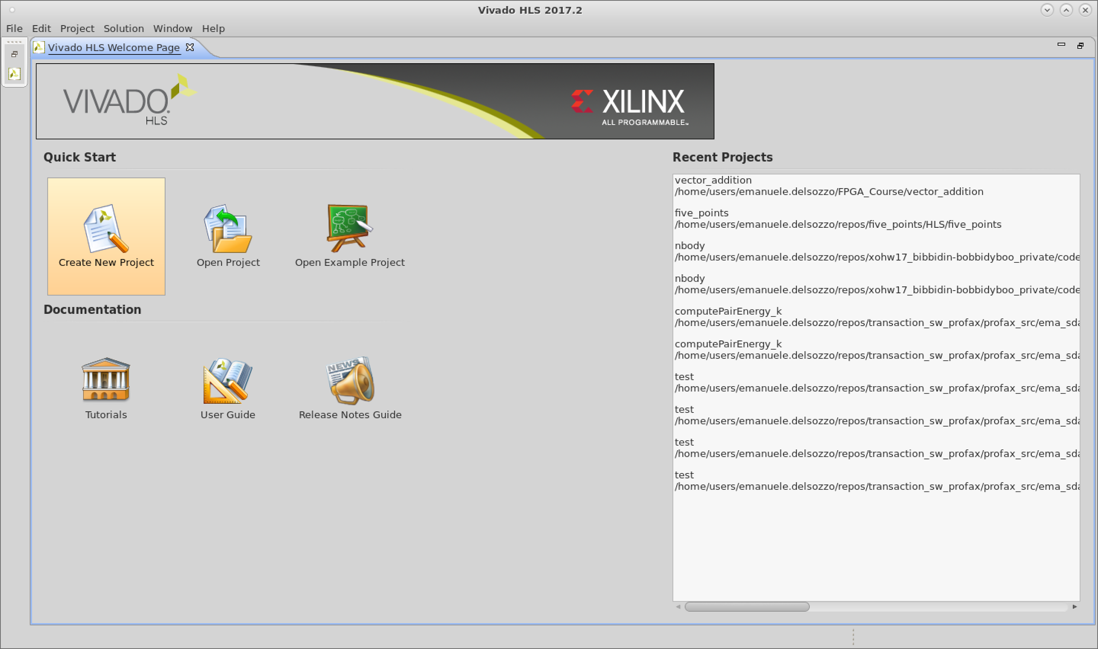
Vivado HLS GUI

Slide 26
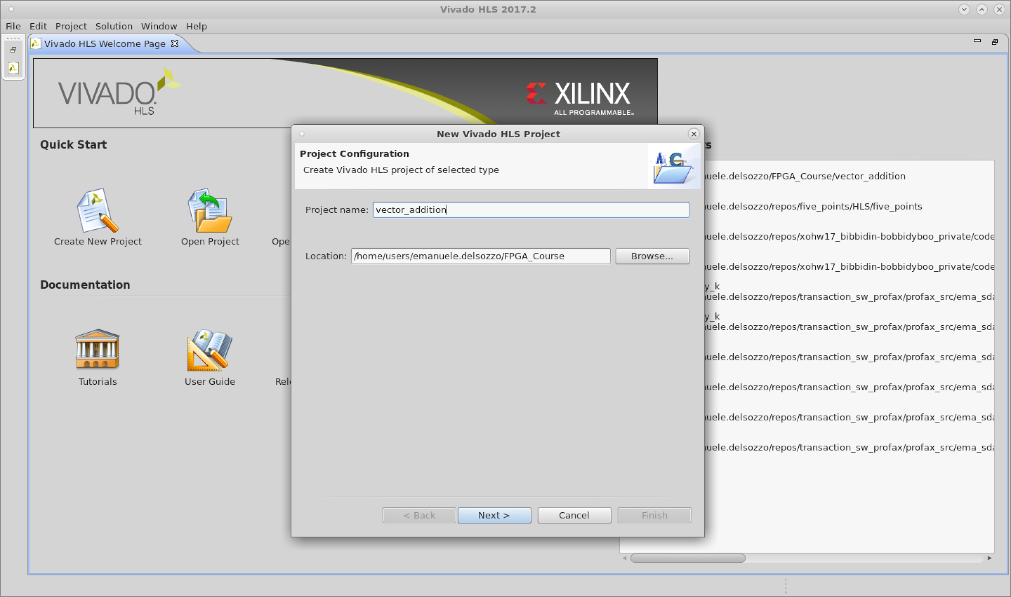
Project Configuration
Text

Slide 27
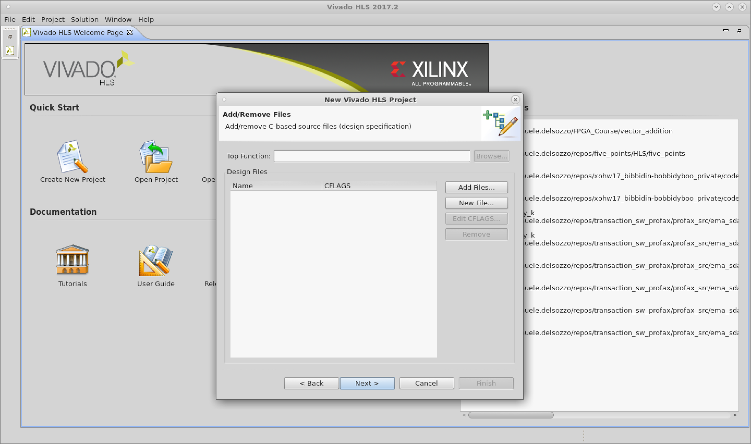
Kernel files
Text
Top Function Selection
Add/create files

Slide 28

Testbench files
Text
Add/create files

Slide 29
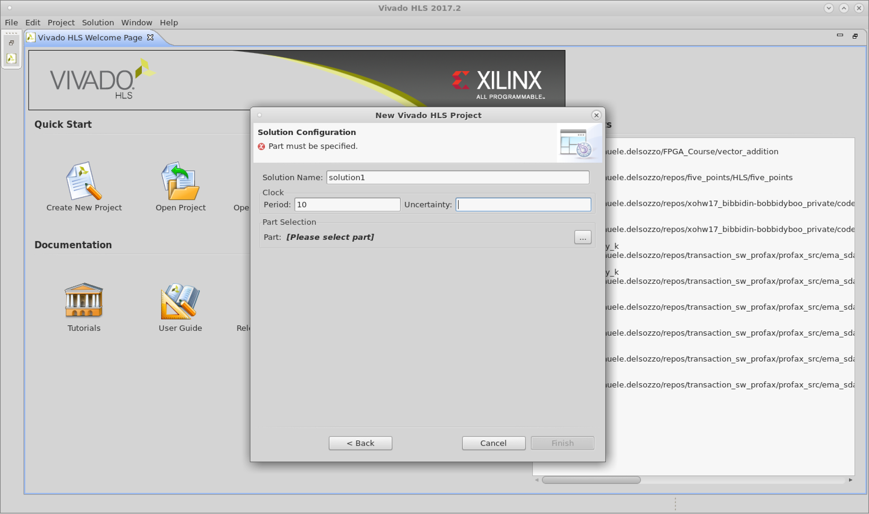
Solution Configuration
Text
Clock period
Part selection

Slide 30
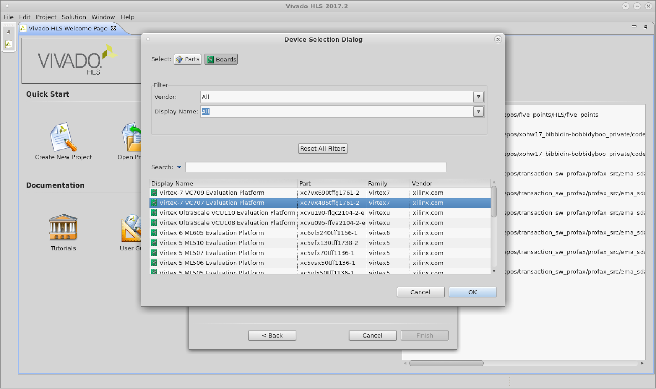
Device Selection
Text
Parts/Boards
Selection

Slide 31
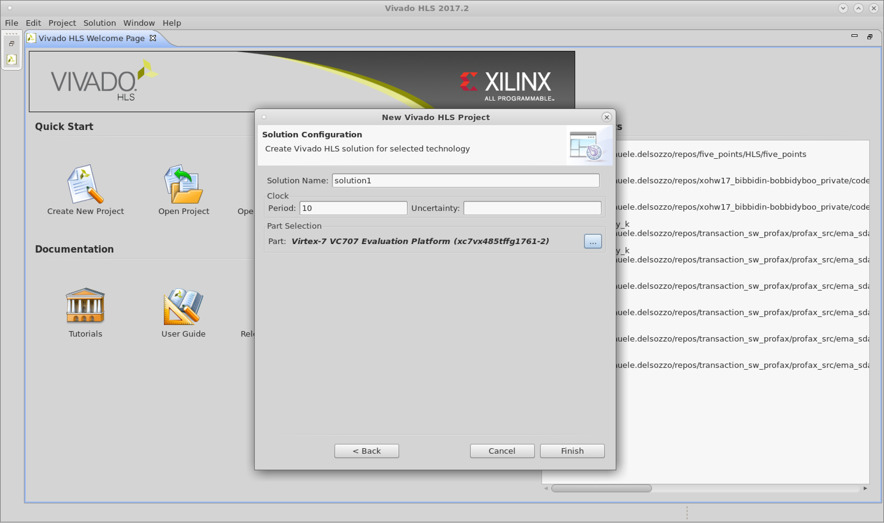
Solution Configuration
Text

Slide 32
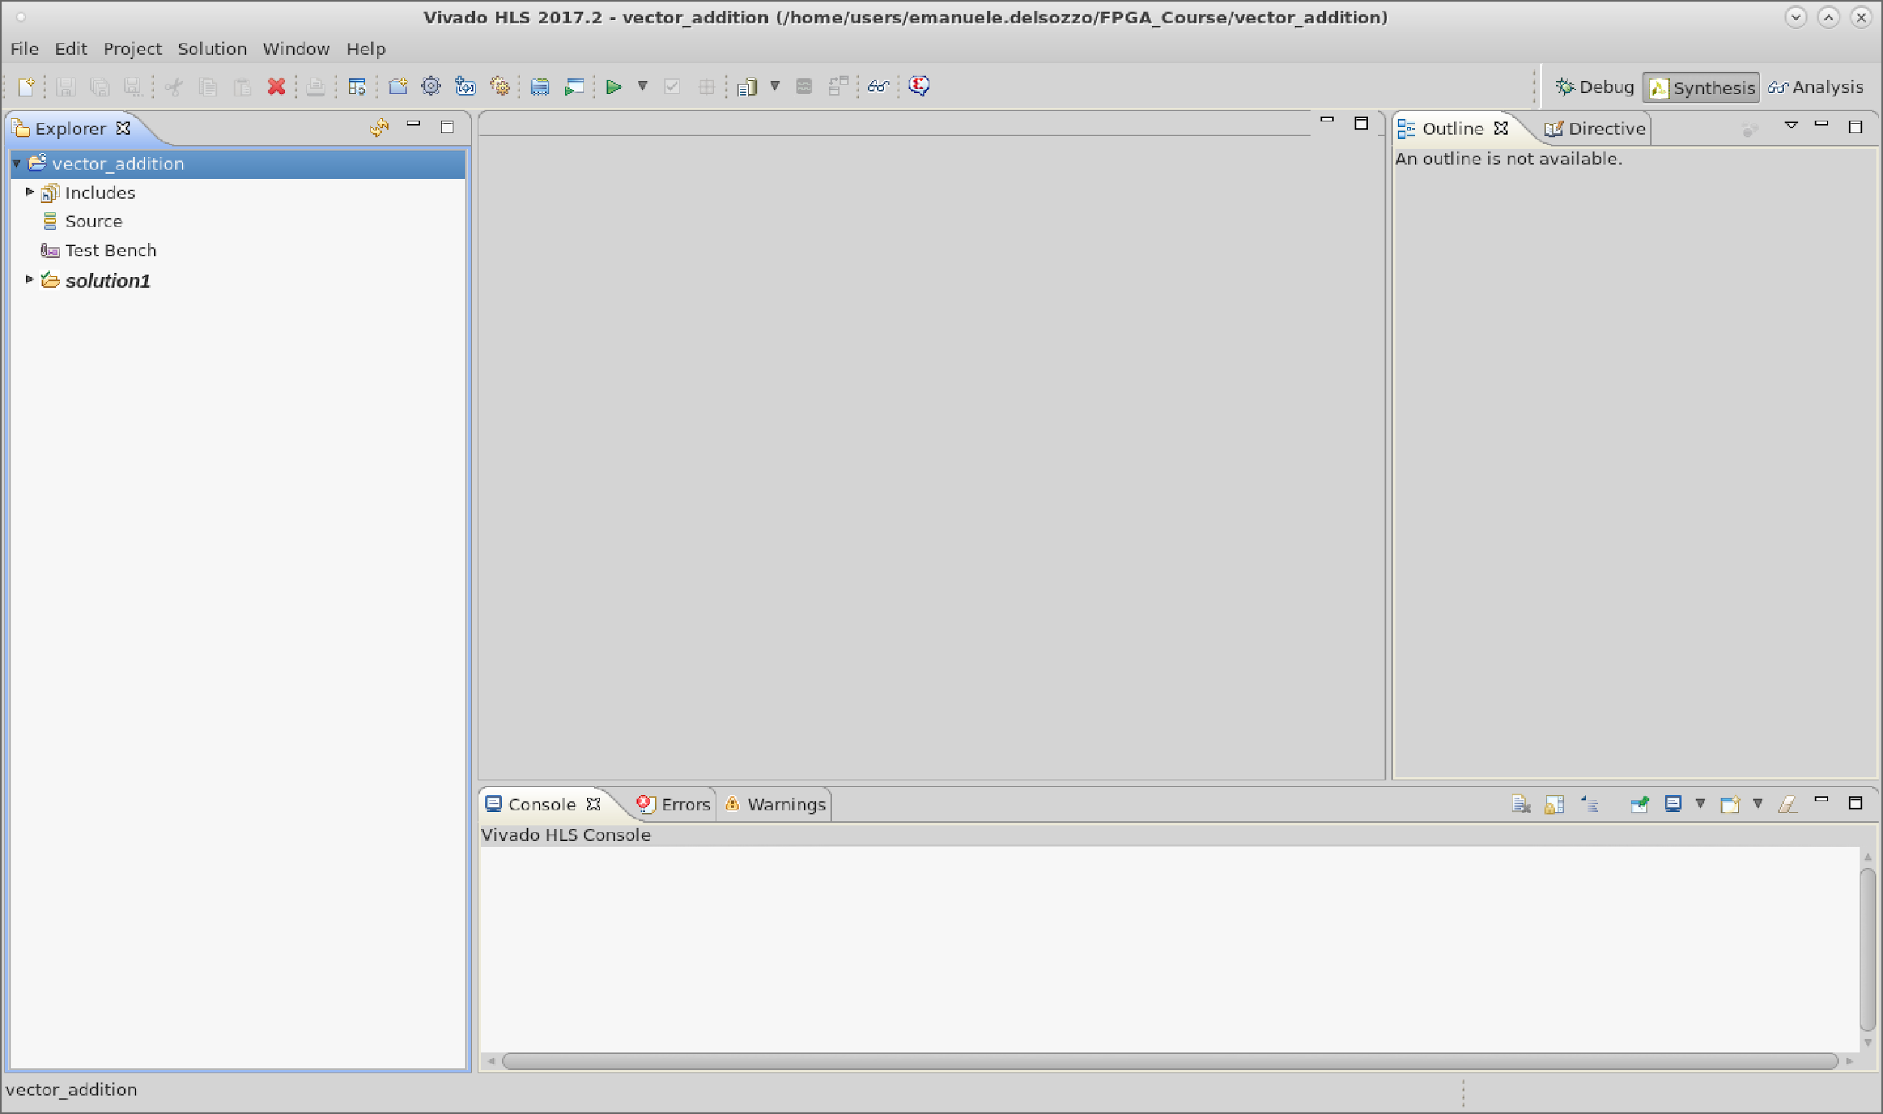
Editor Interface
Text
Project
Files
Files
Editor
Outline /
Directive
Vivado HLS
Console

Slide 33
Editor Interface
Text
Project
Settings
Run
Synthesis
Solution
Settings
Run
C Simulation

Slide 34
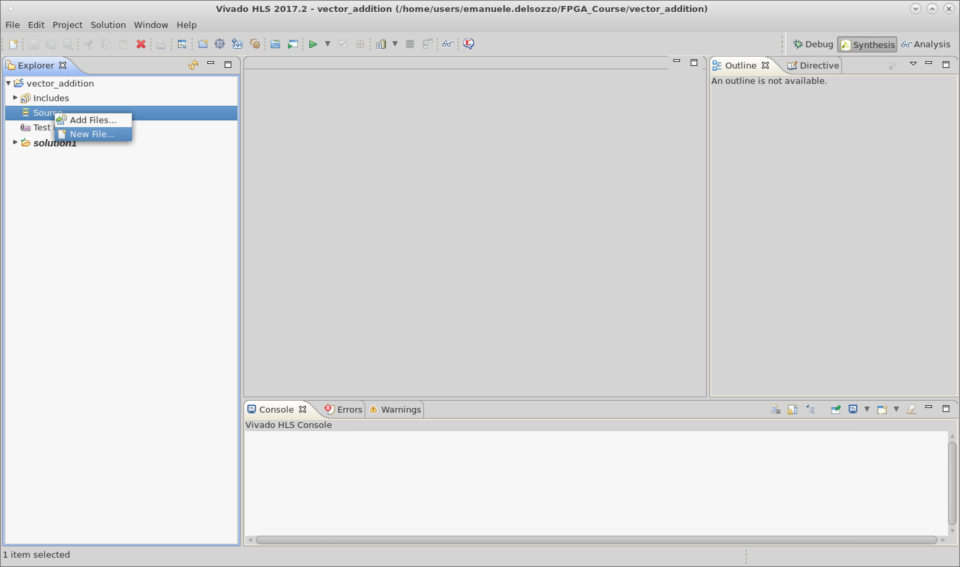
Kernel Creation
Text

Slide 35
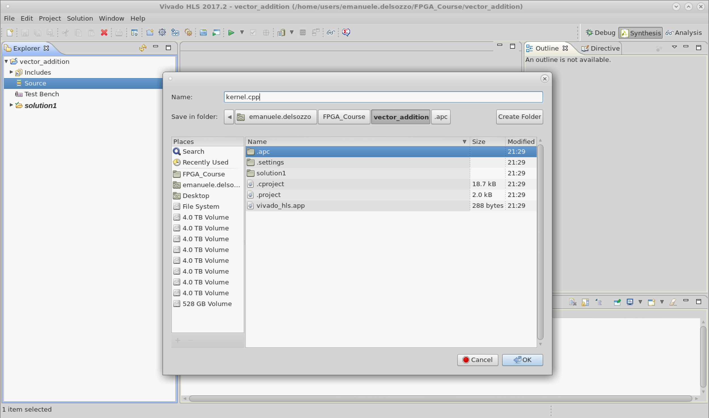
Kernel Creation
Text

Slide 36
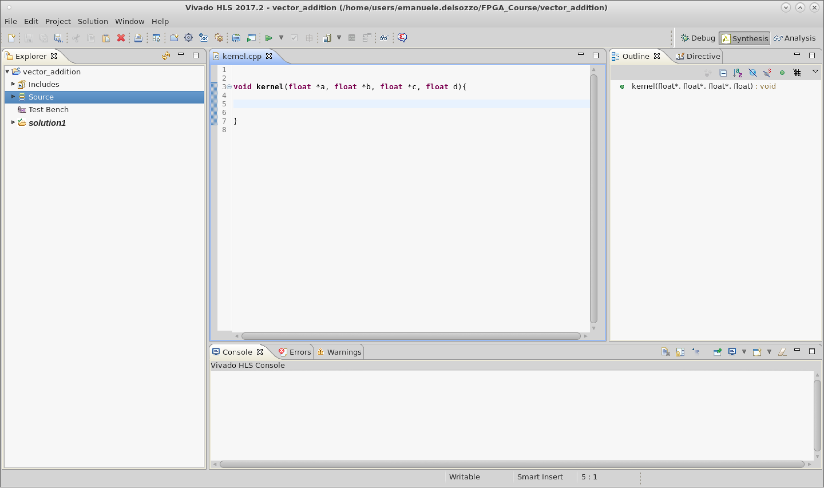
Kernel function
Text

Slide 37
Kernel function
Text
Let’s add the directives for
the communication interfaces

Slide 38
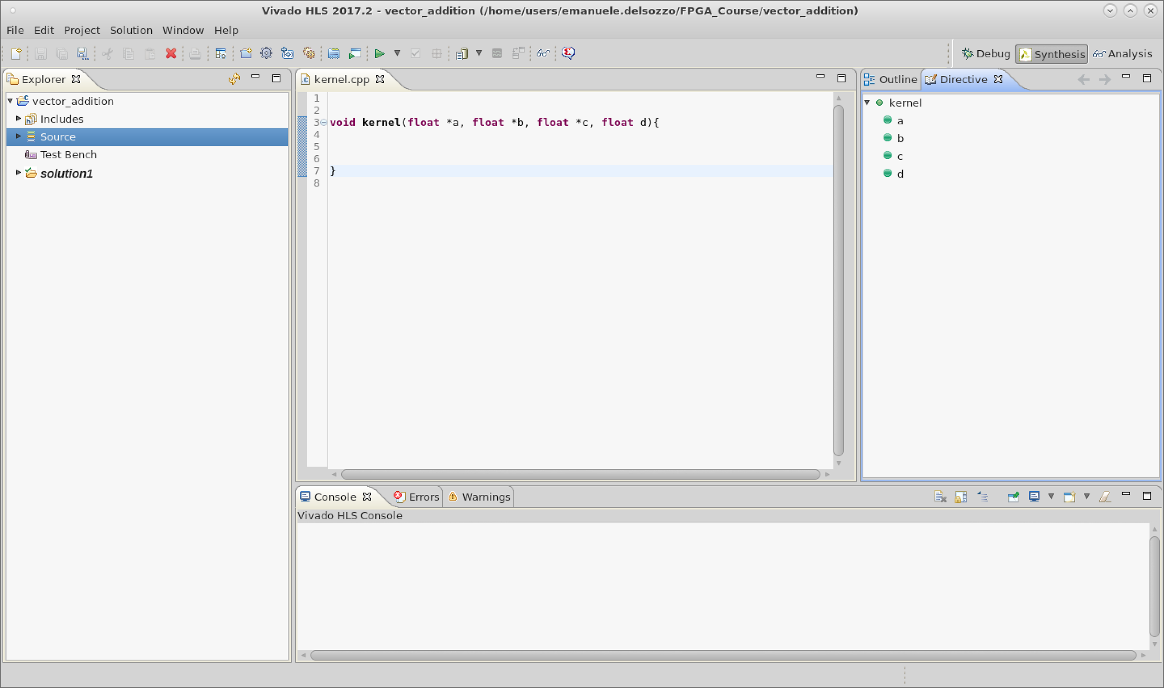
Directives
Text
Directives tab

Slide 39
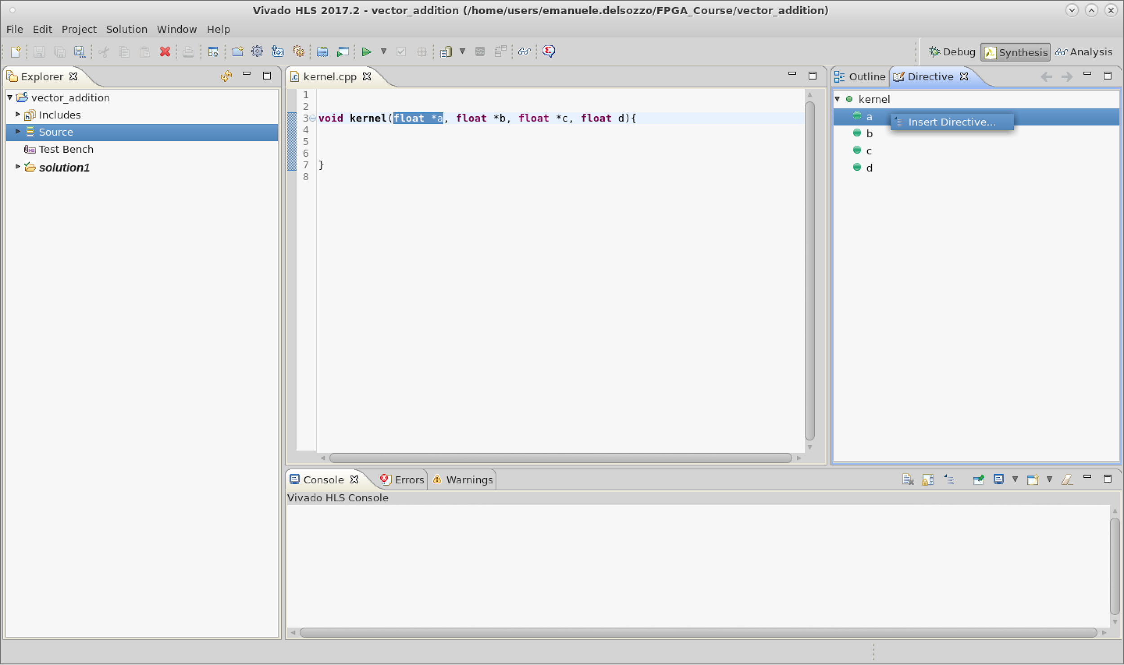
Insert Directive for port a
Text

Slide 40
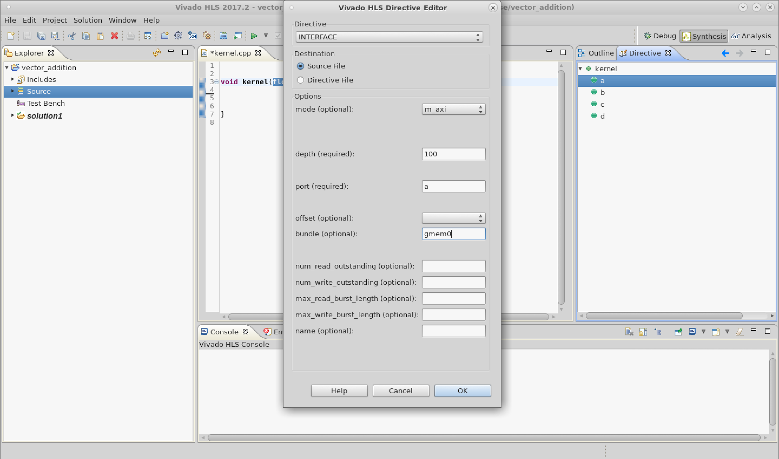
Master Axi Directive
Text

Slide 41
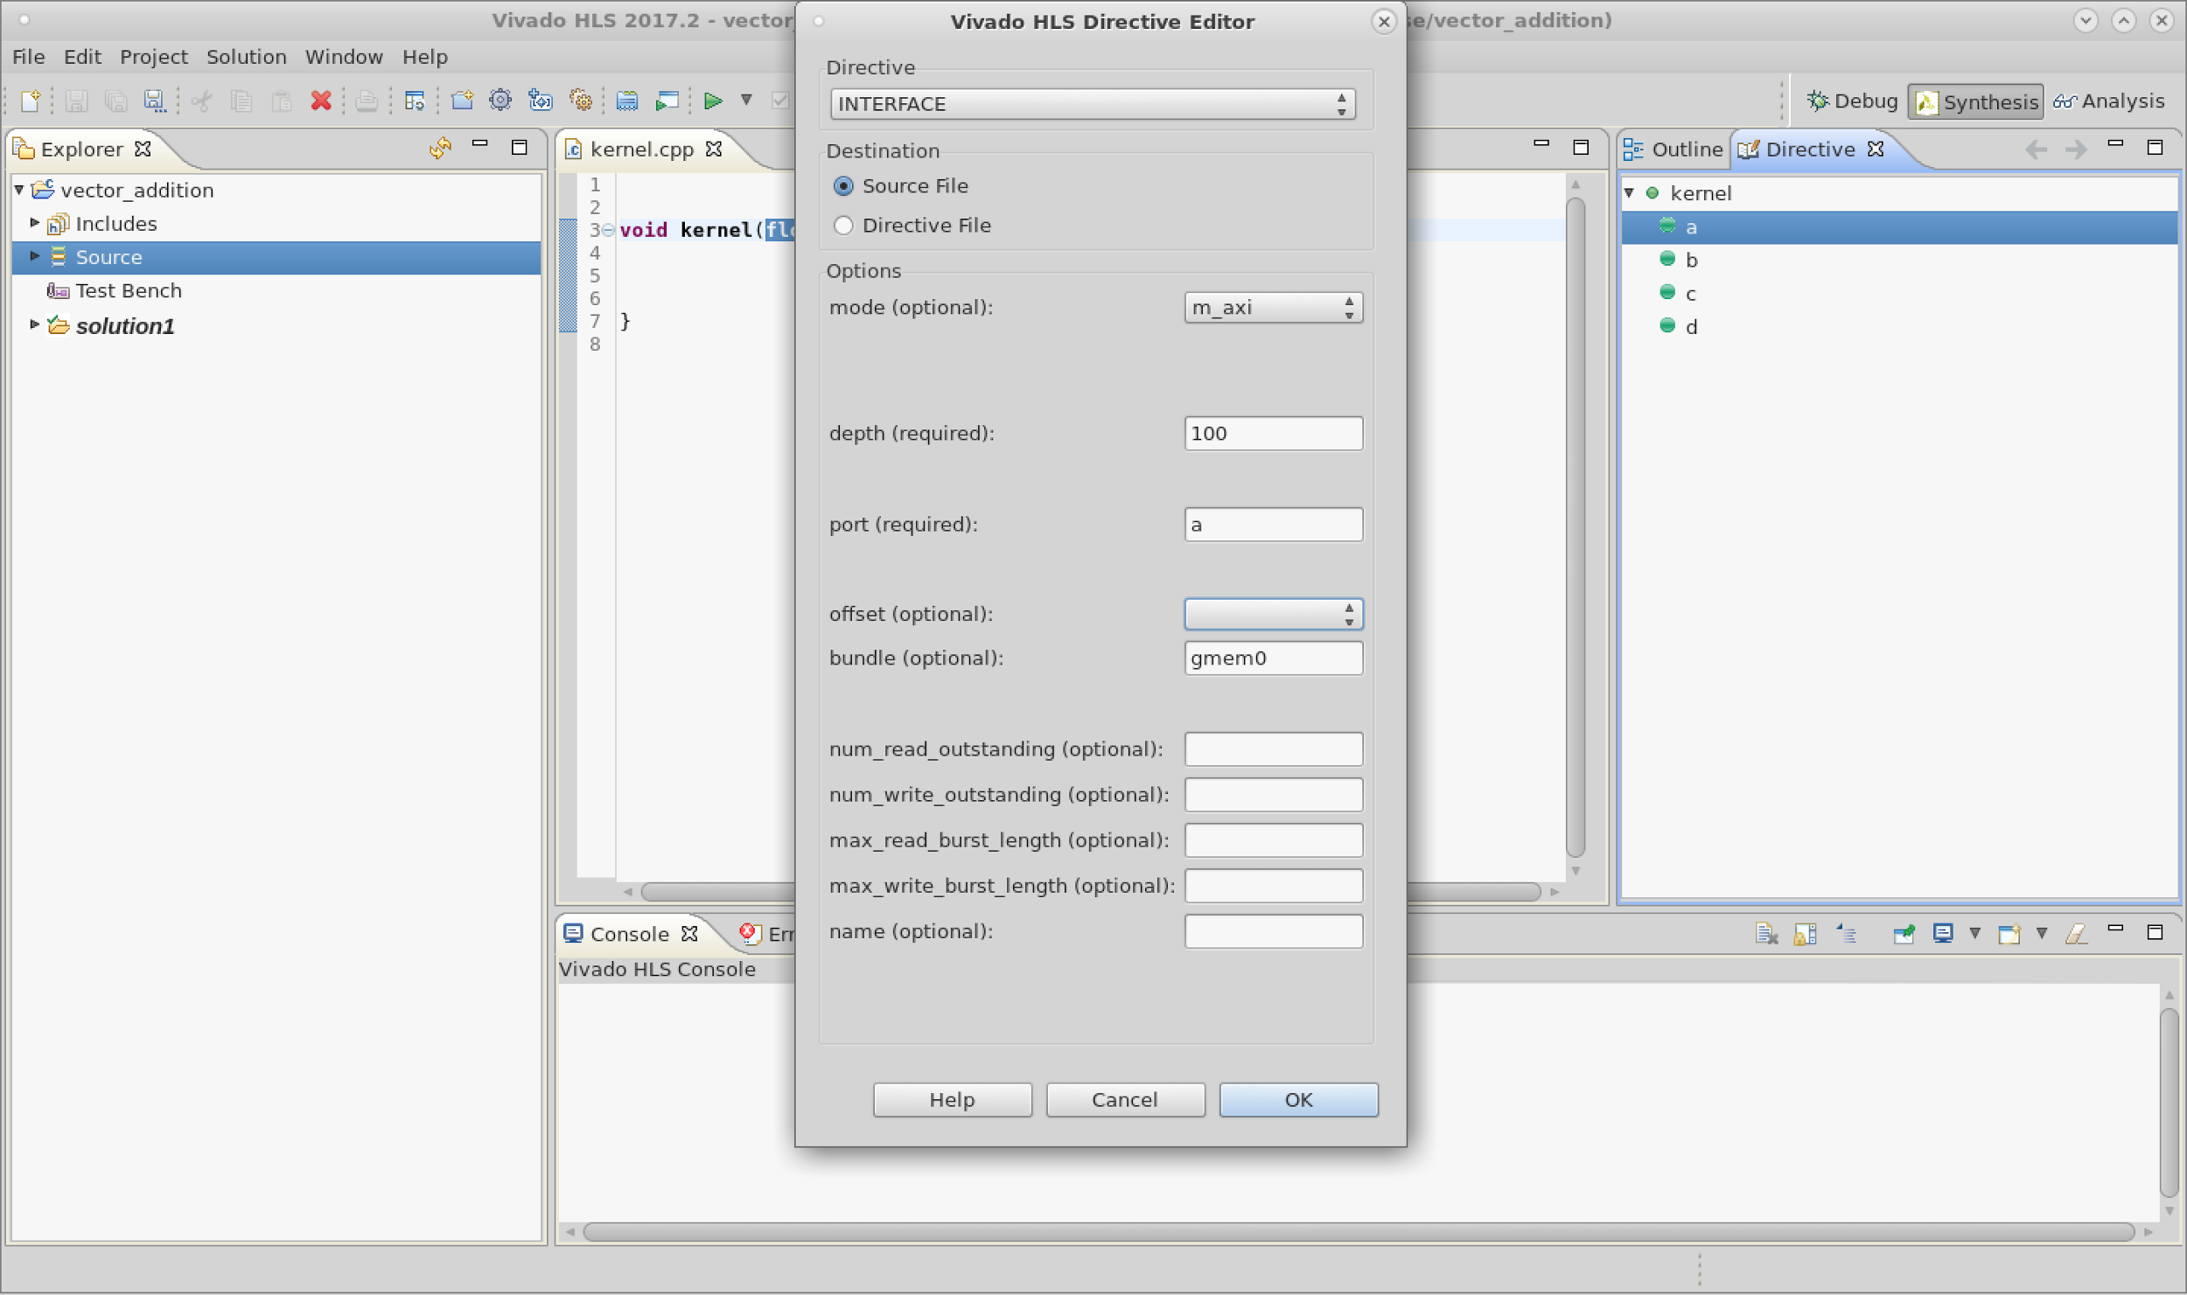
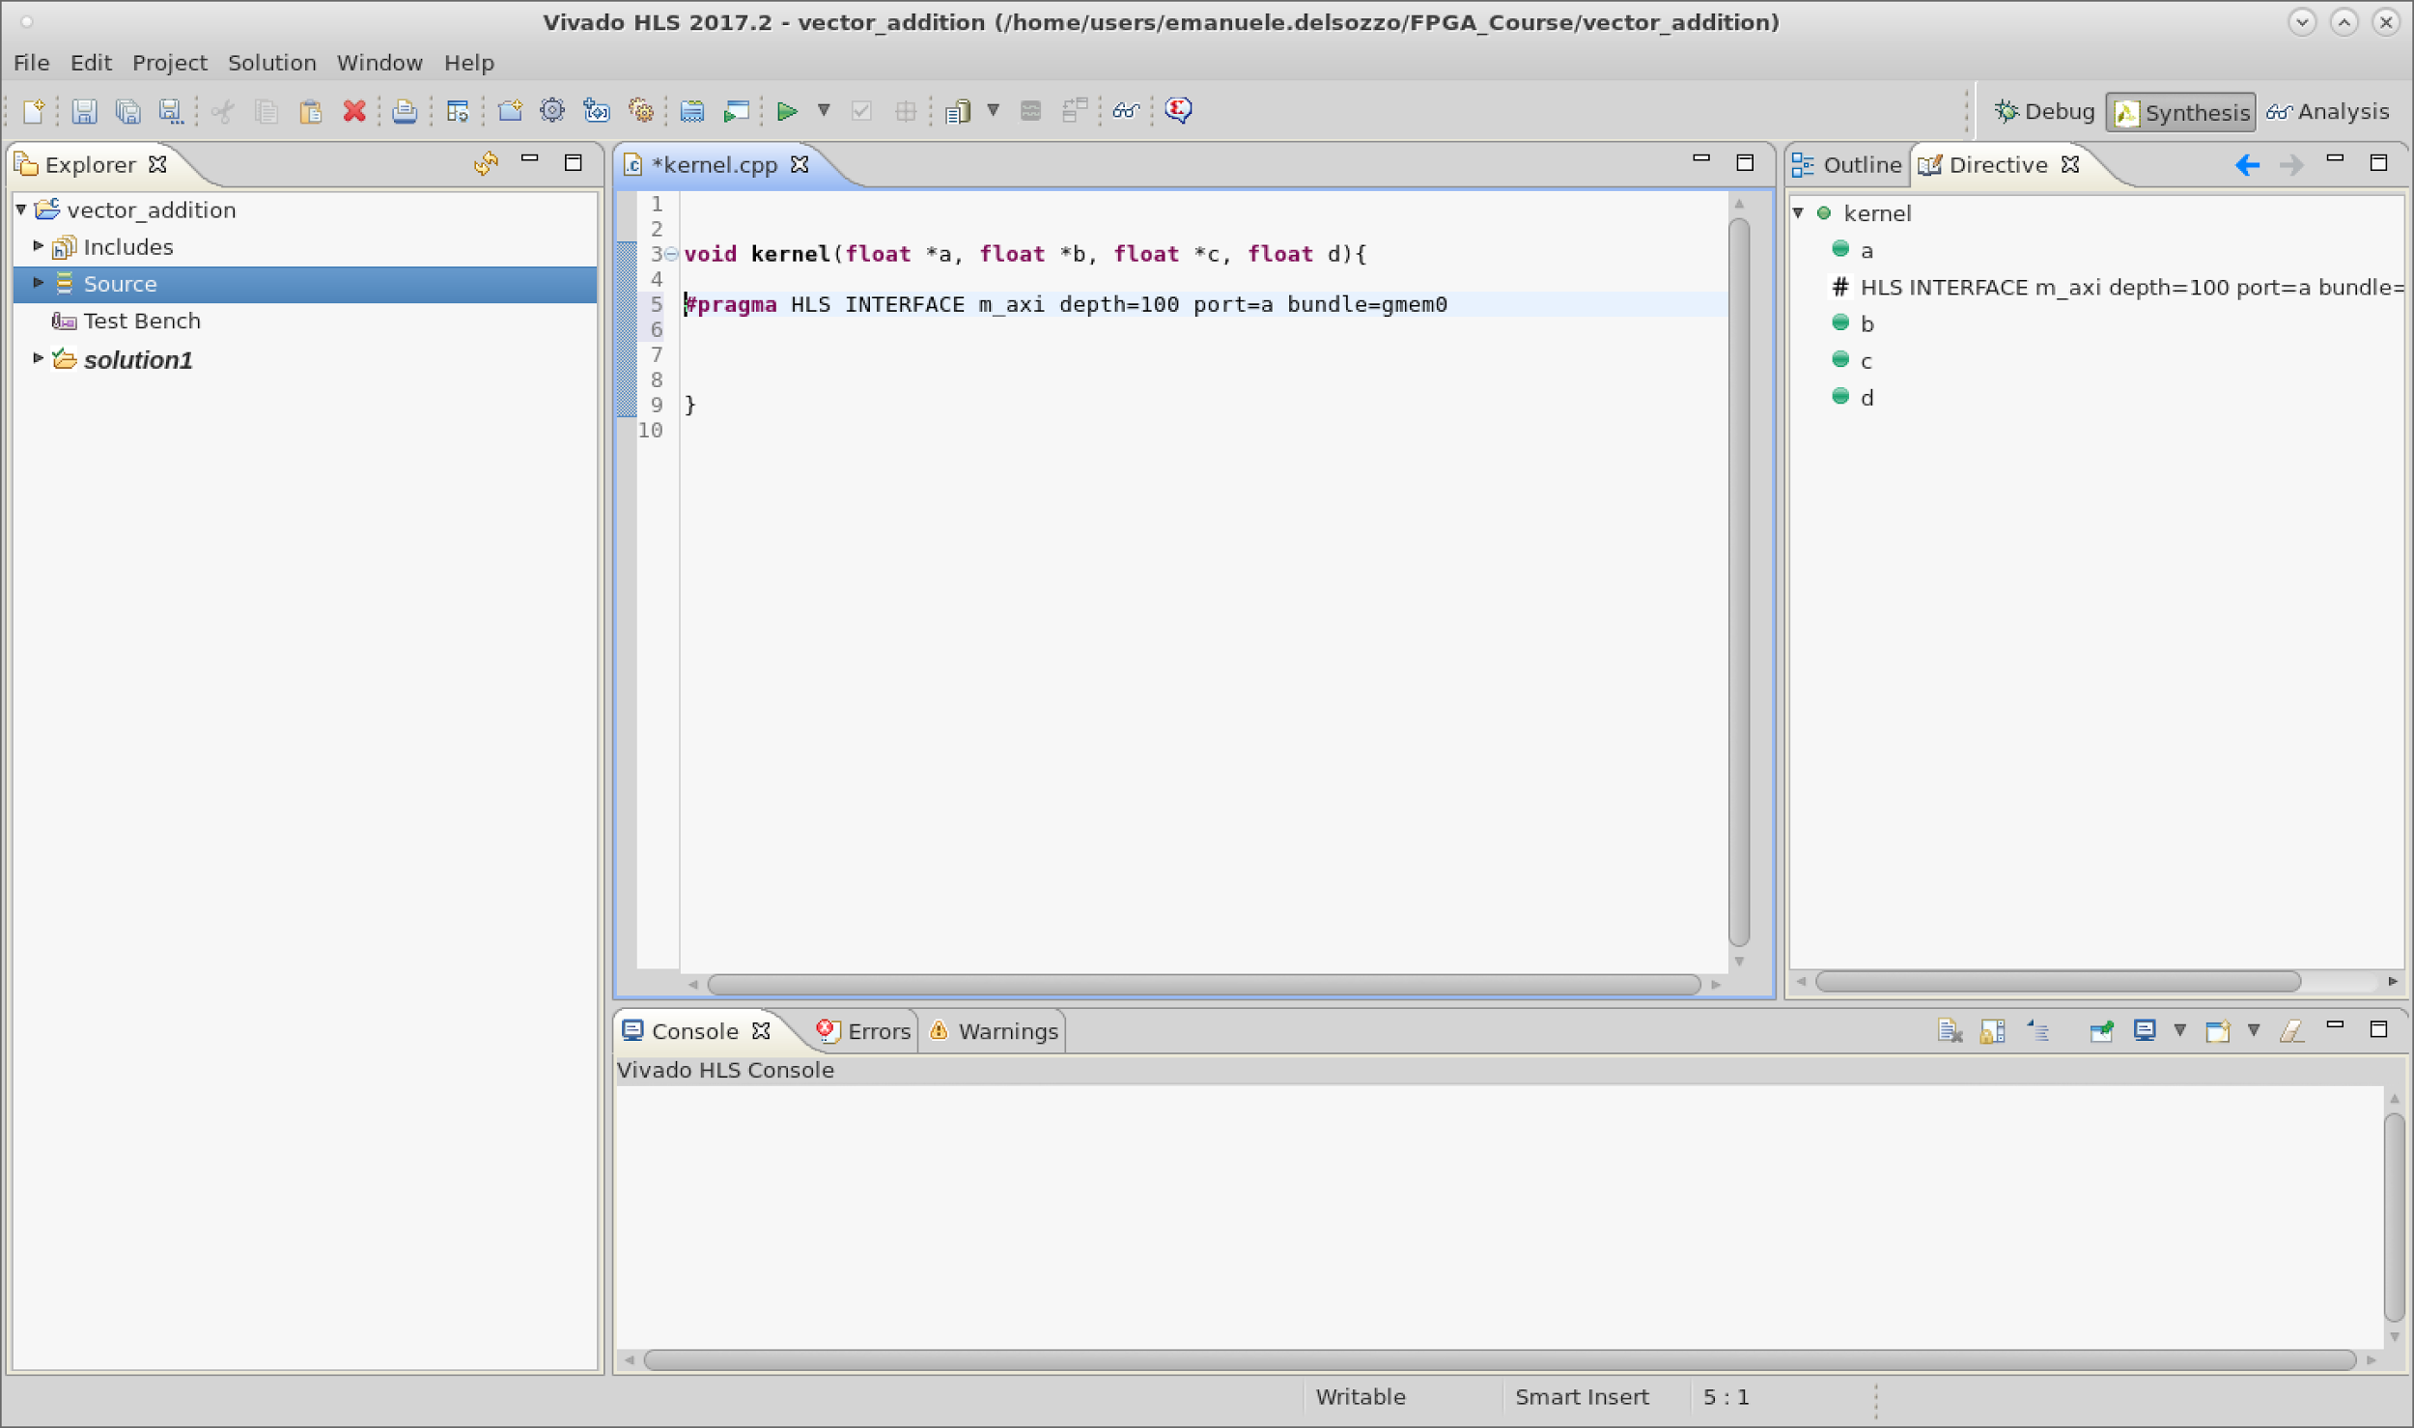
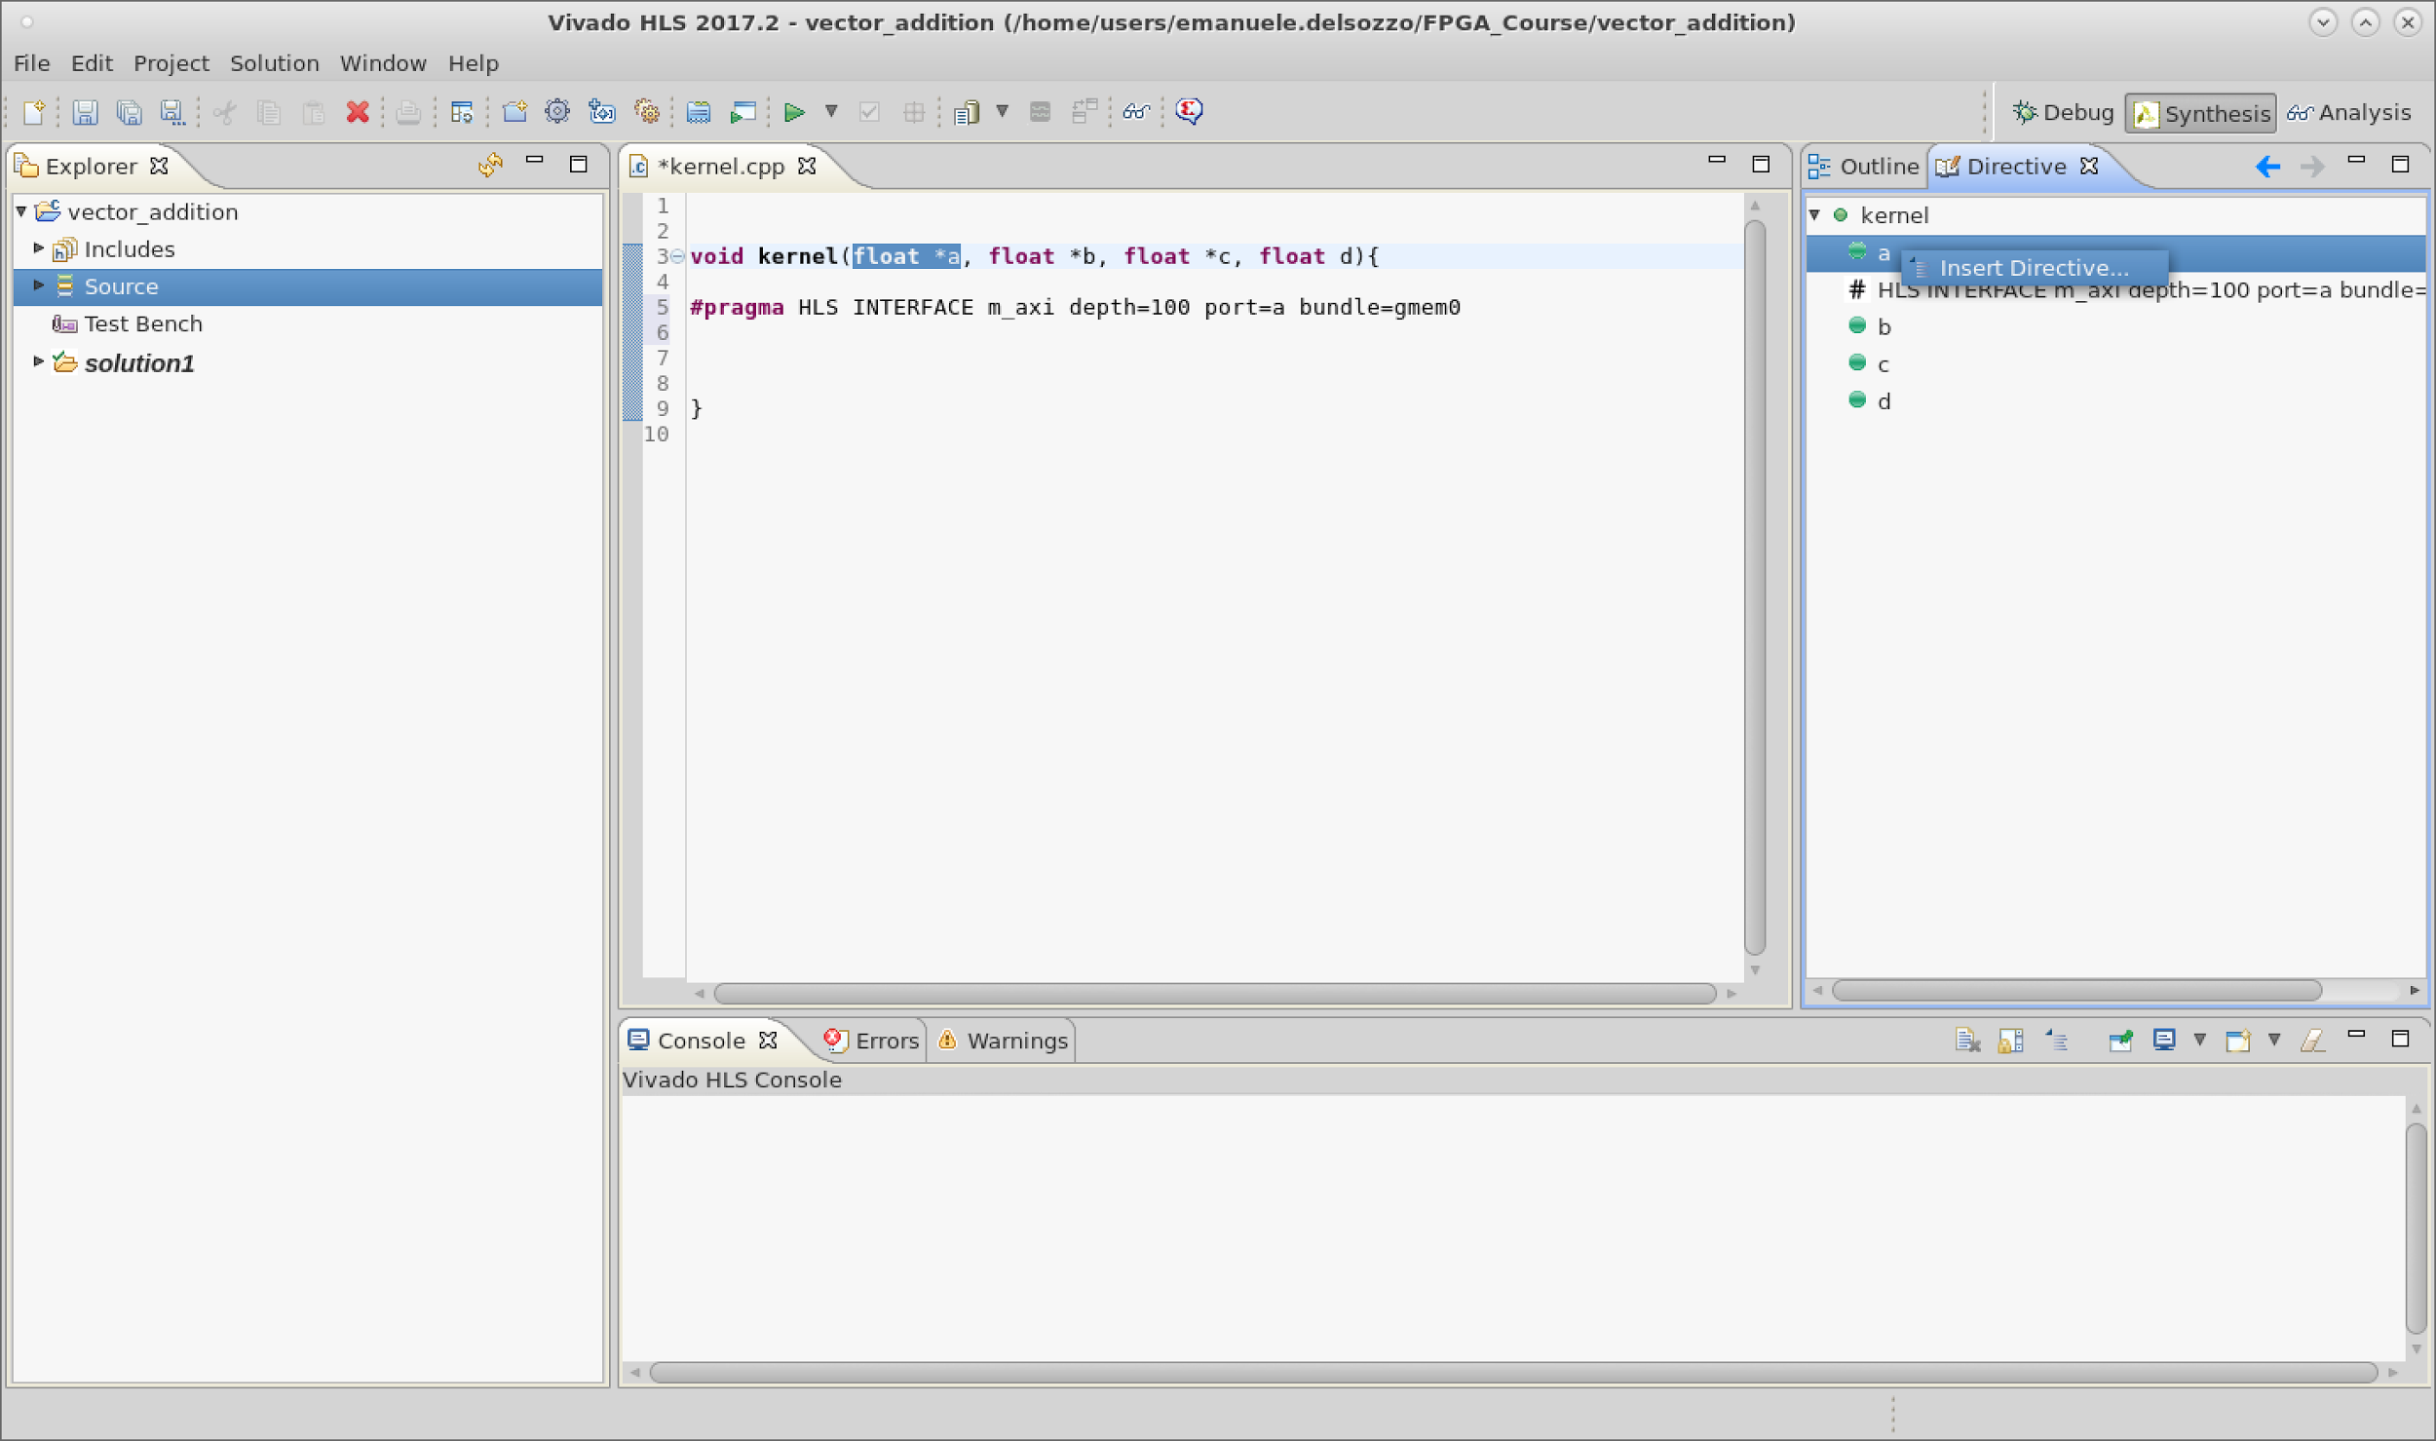
Insert Directive for port a
Text

Slide 42
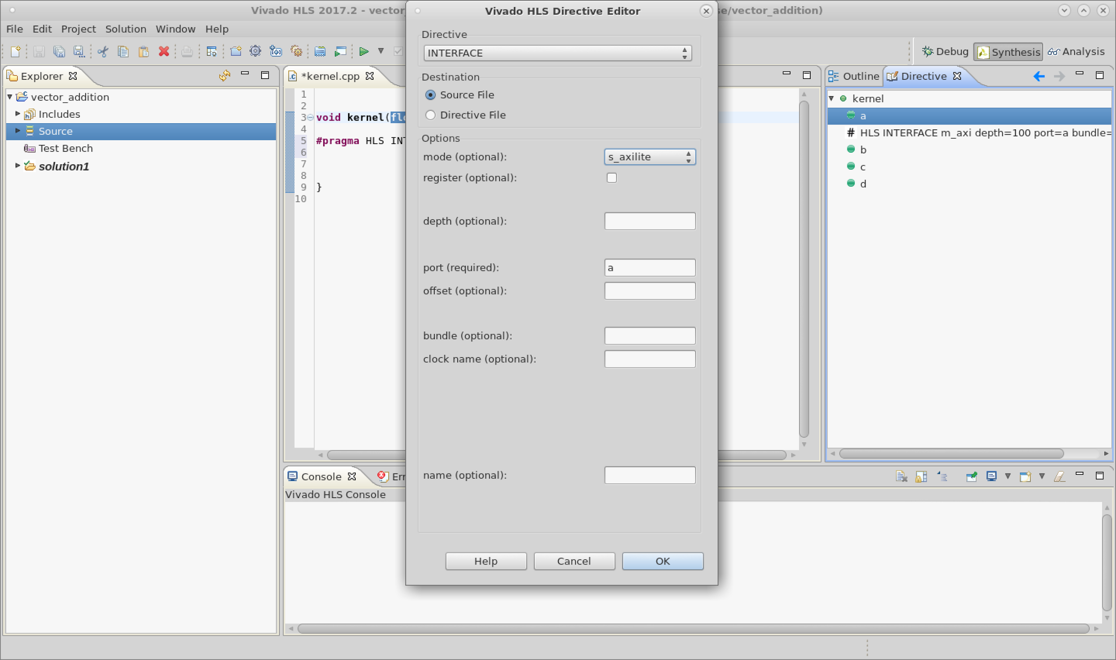
Axilite Directive
Text

Slide 43
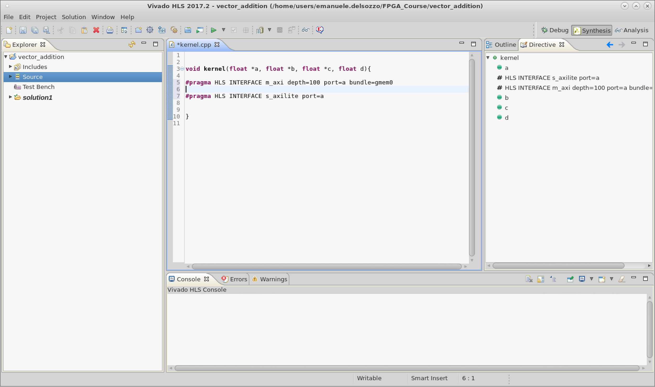
Port a directives
Text

Slide 44
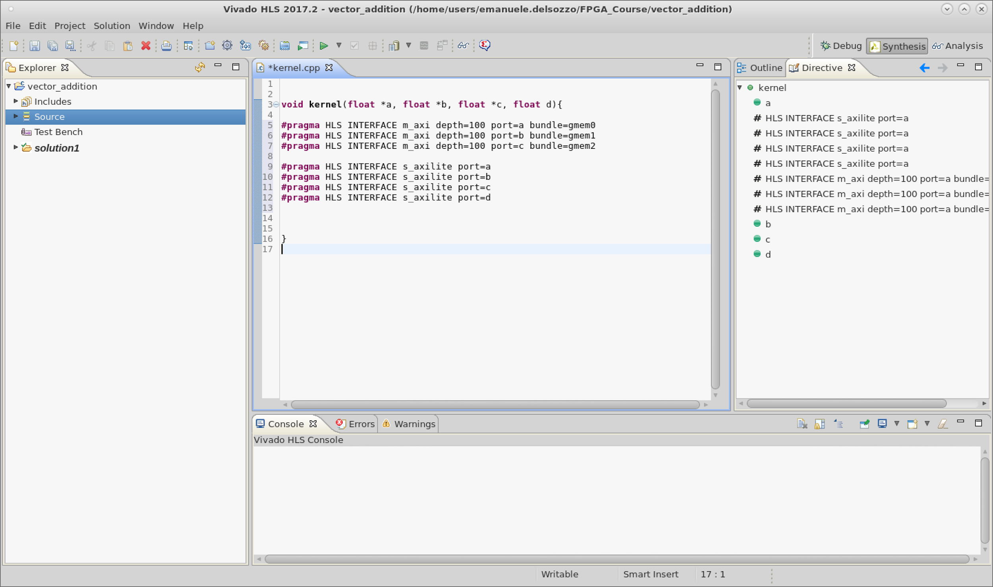
Ports directives
Text
Only axilite for port d
We pass it as a control signal

Slide 45
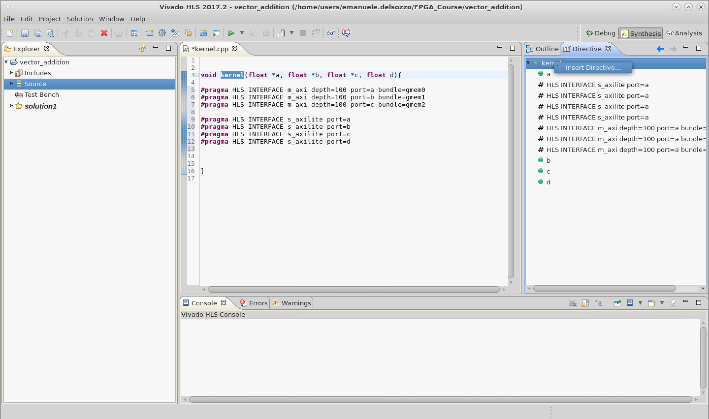
Insert Directive for kernel
Text

Slide 46
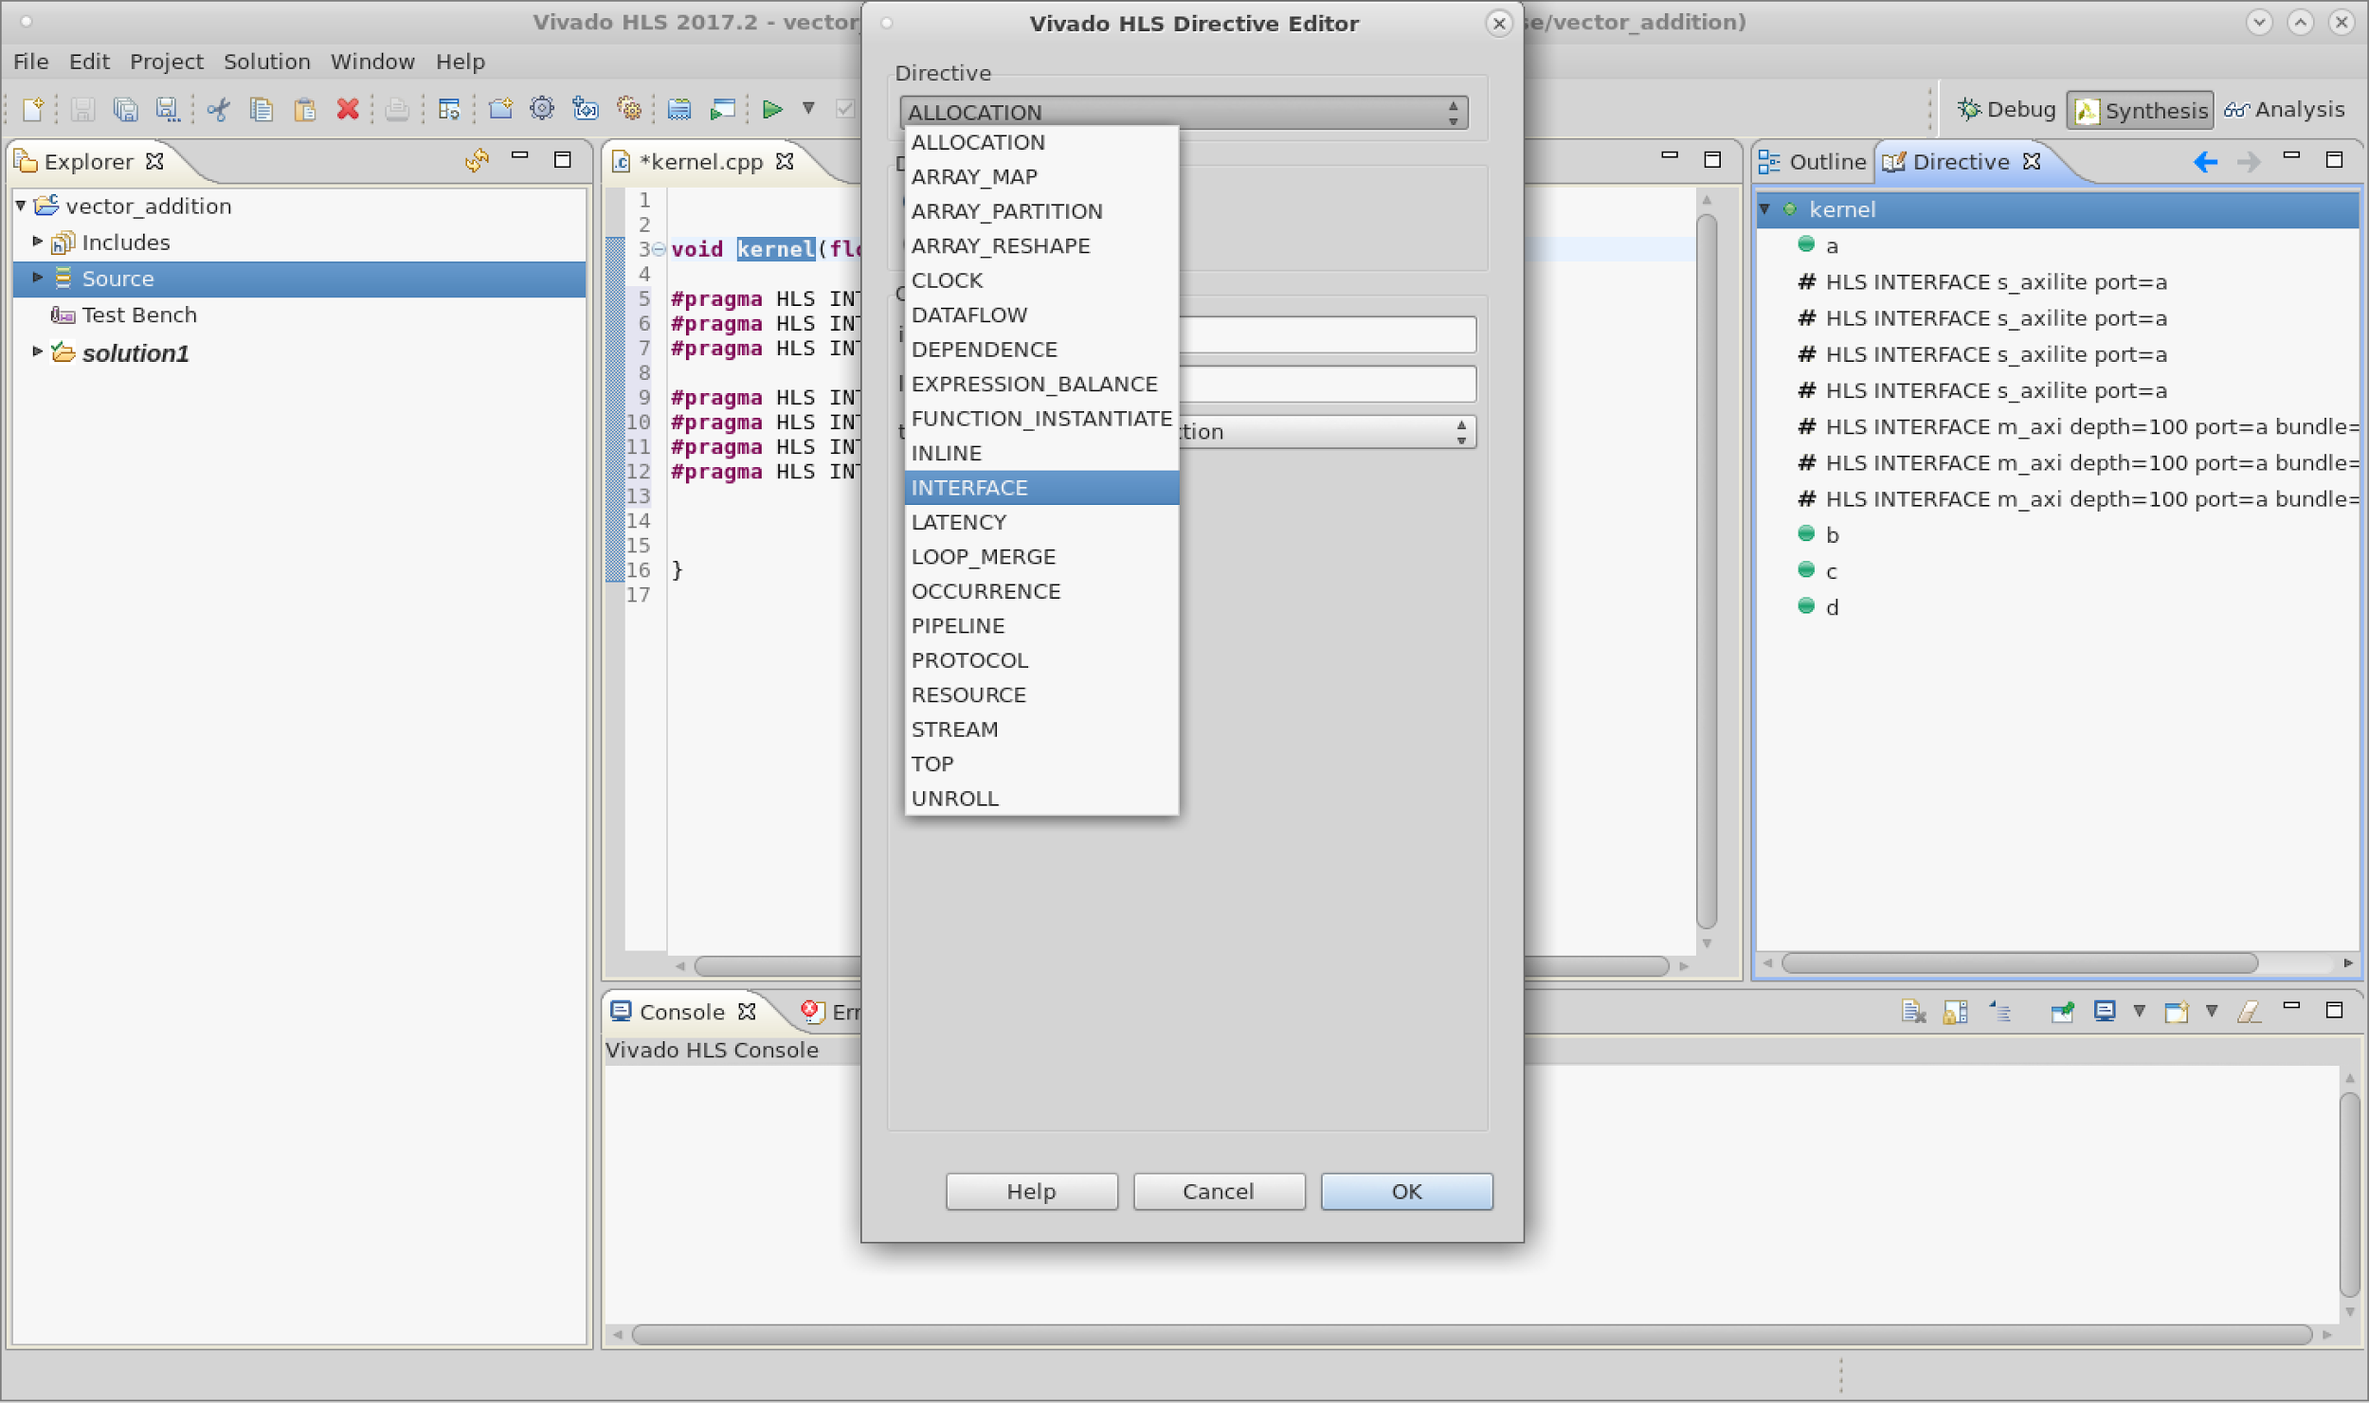
Interface Directive
Text

Slide 47
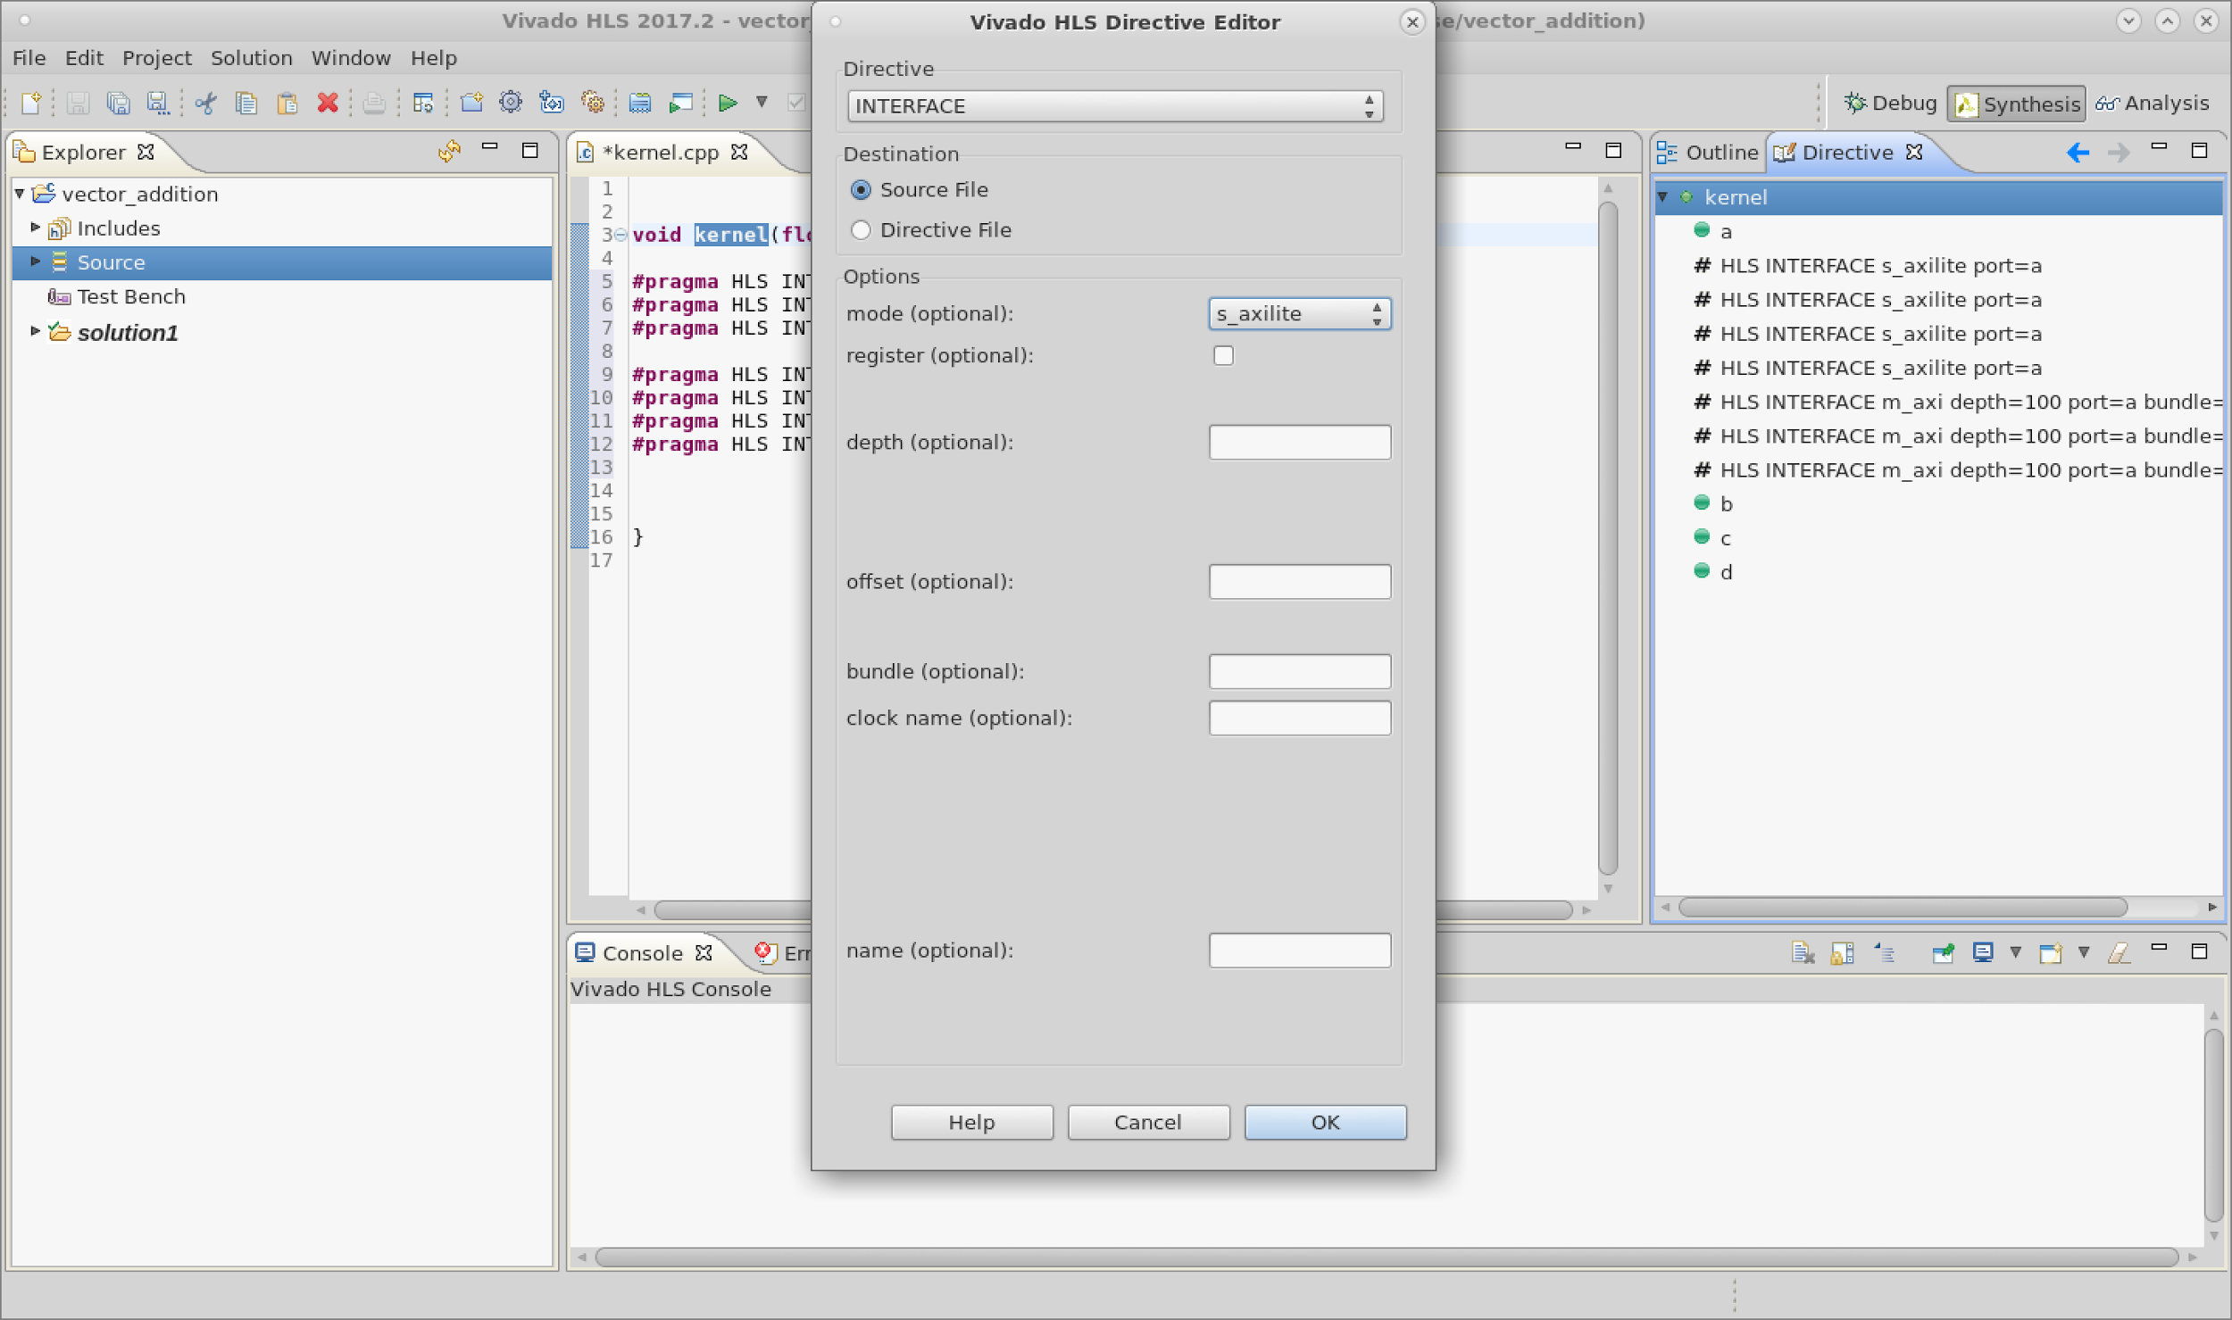
Axilite Directive
Text

Slide 48
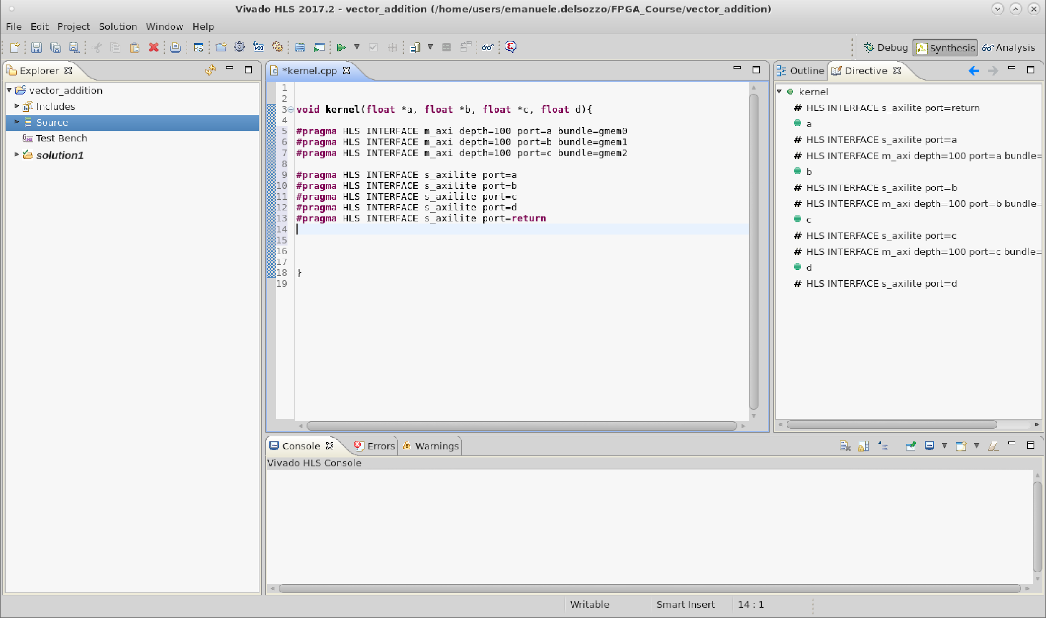
Kernel Directive
Text

Slide 49
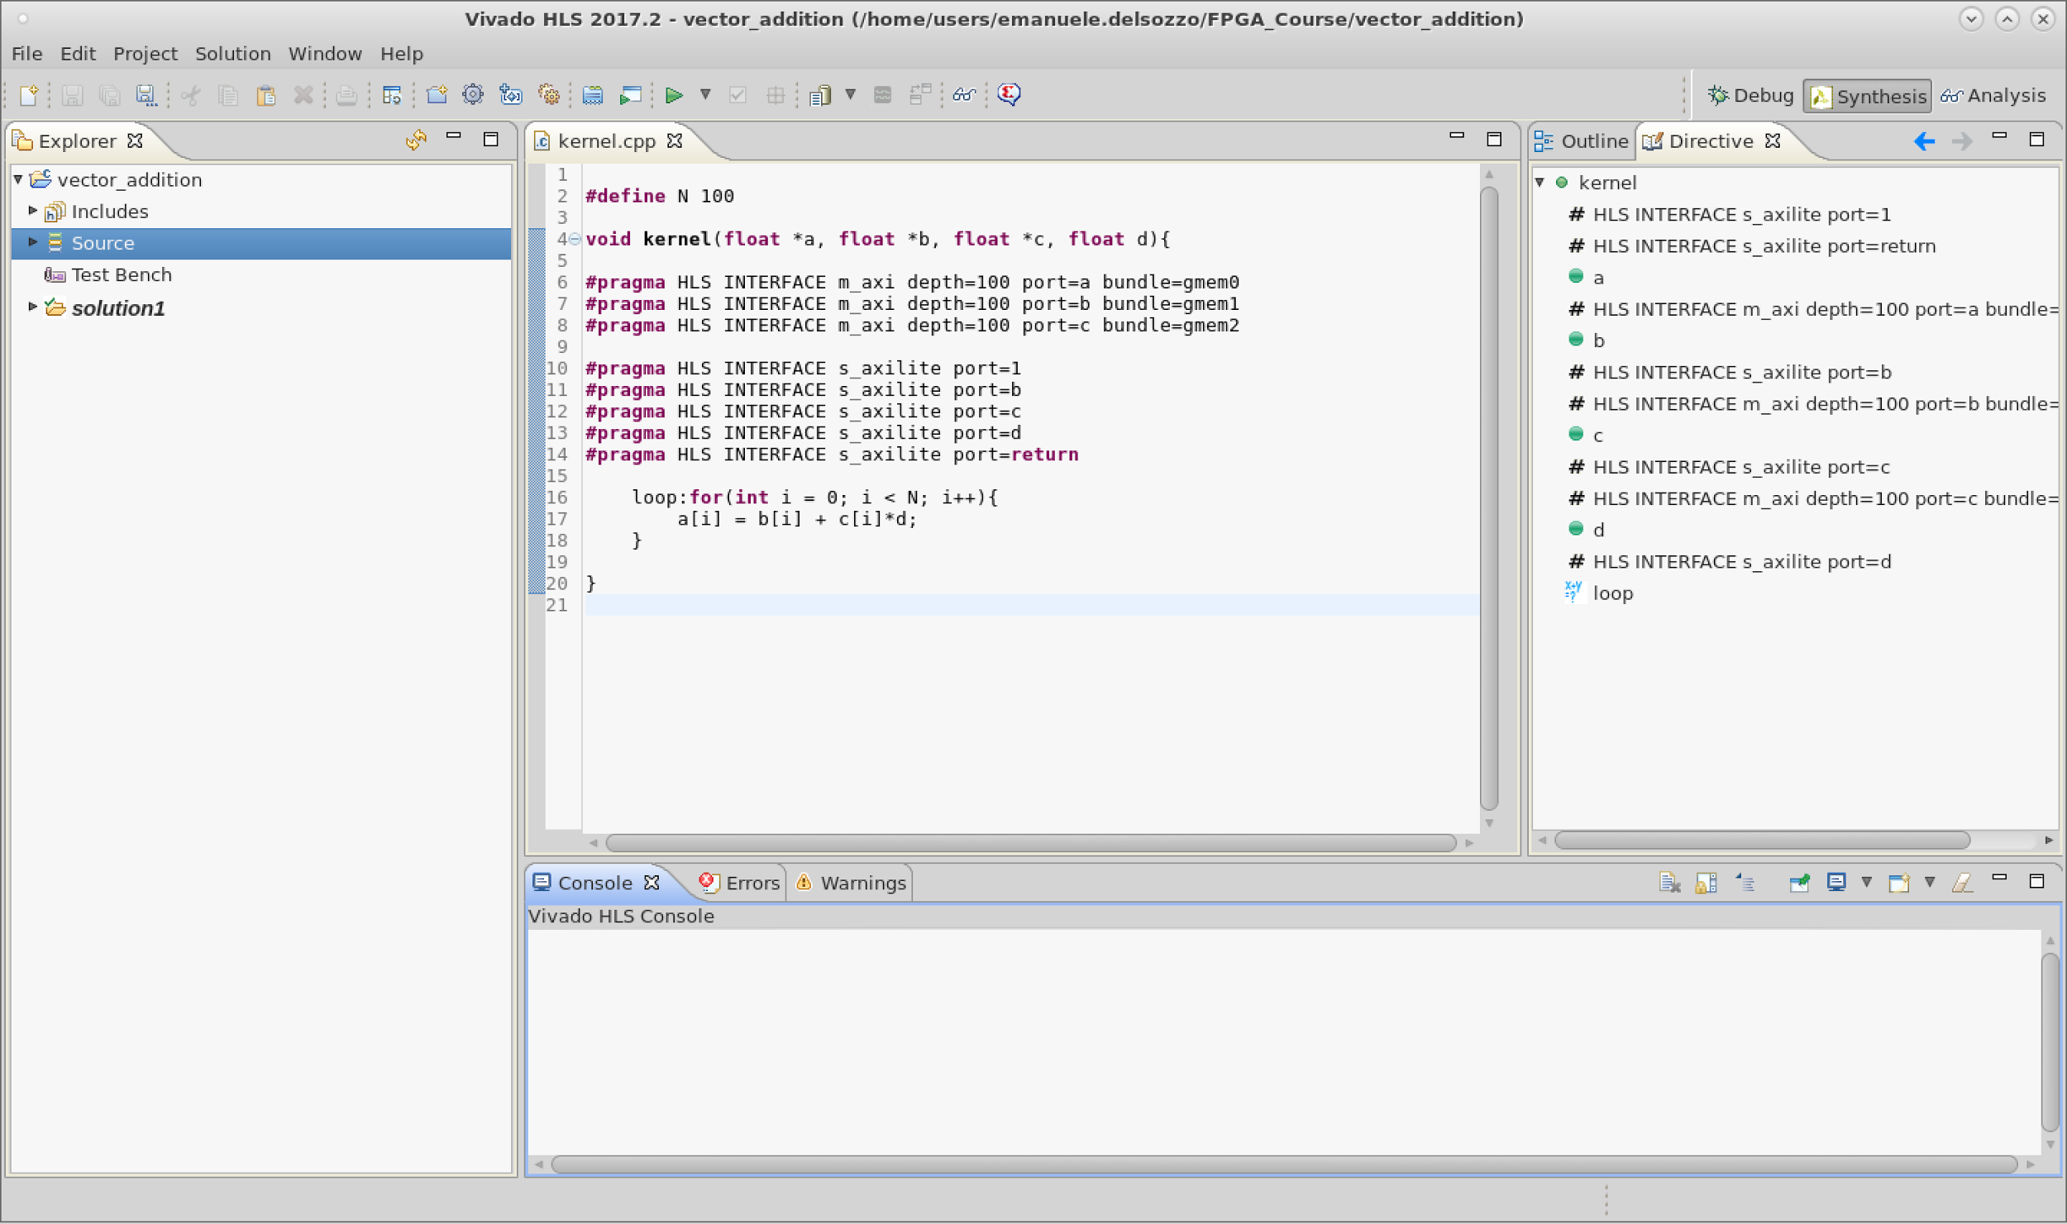
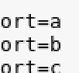
Naive Implementation
Text

Slide 50
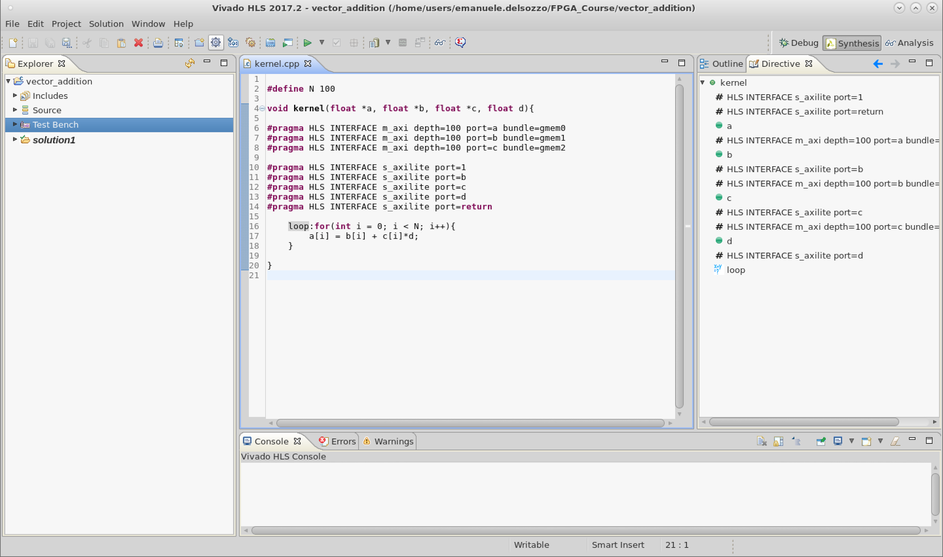
Project Settings
Text

Slide 51
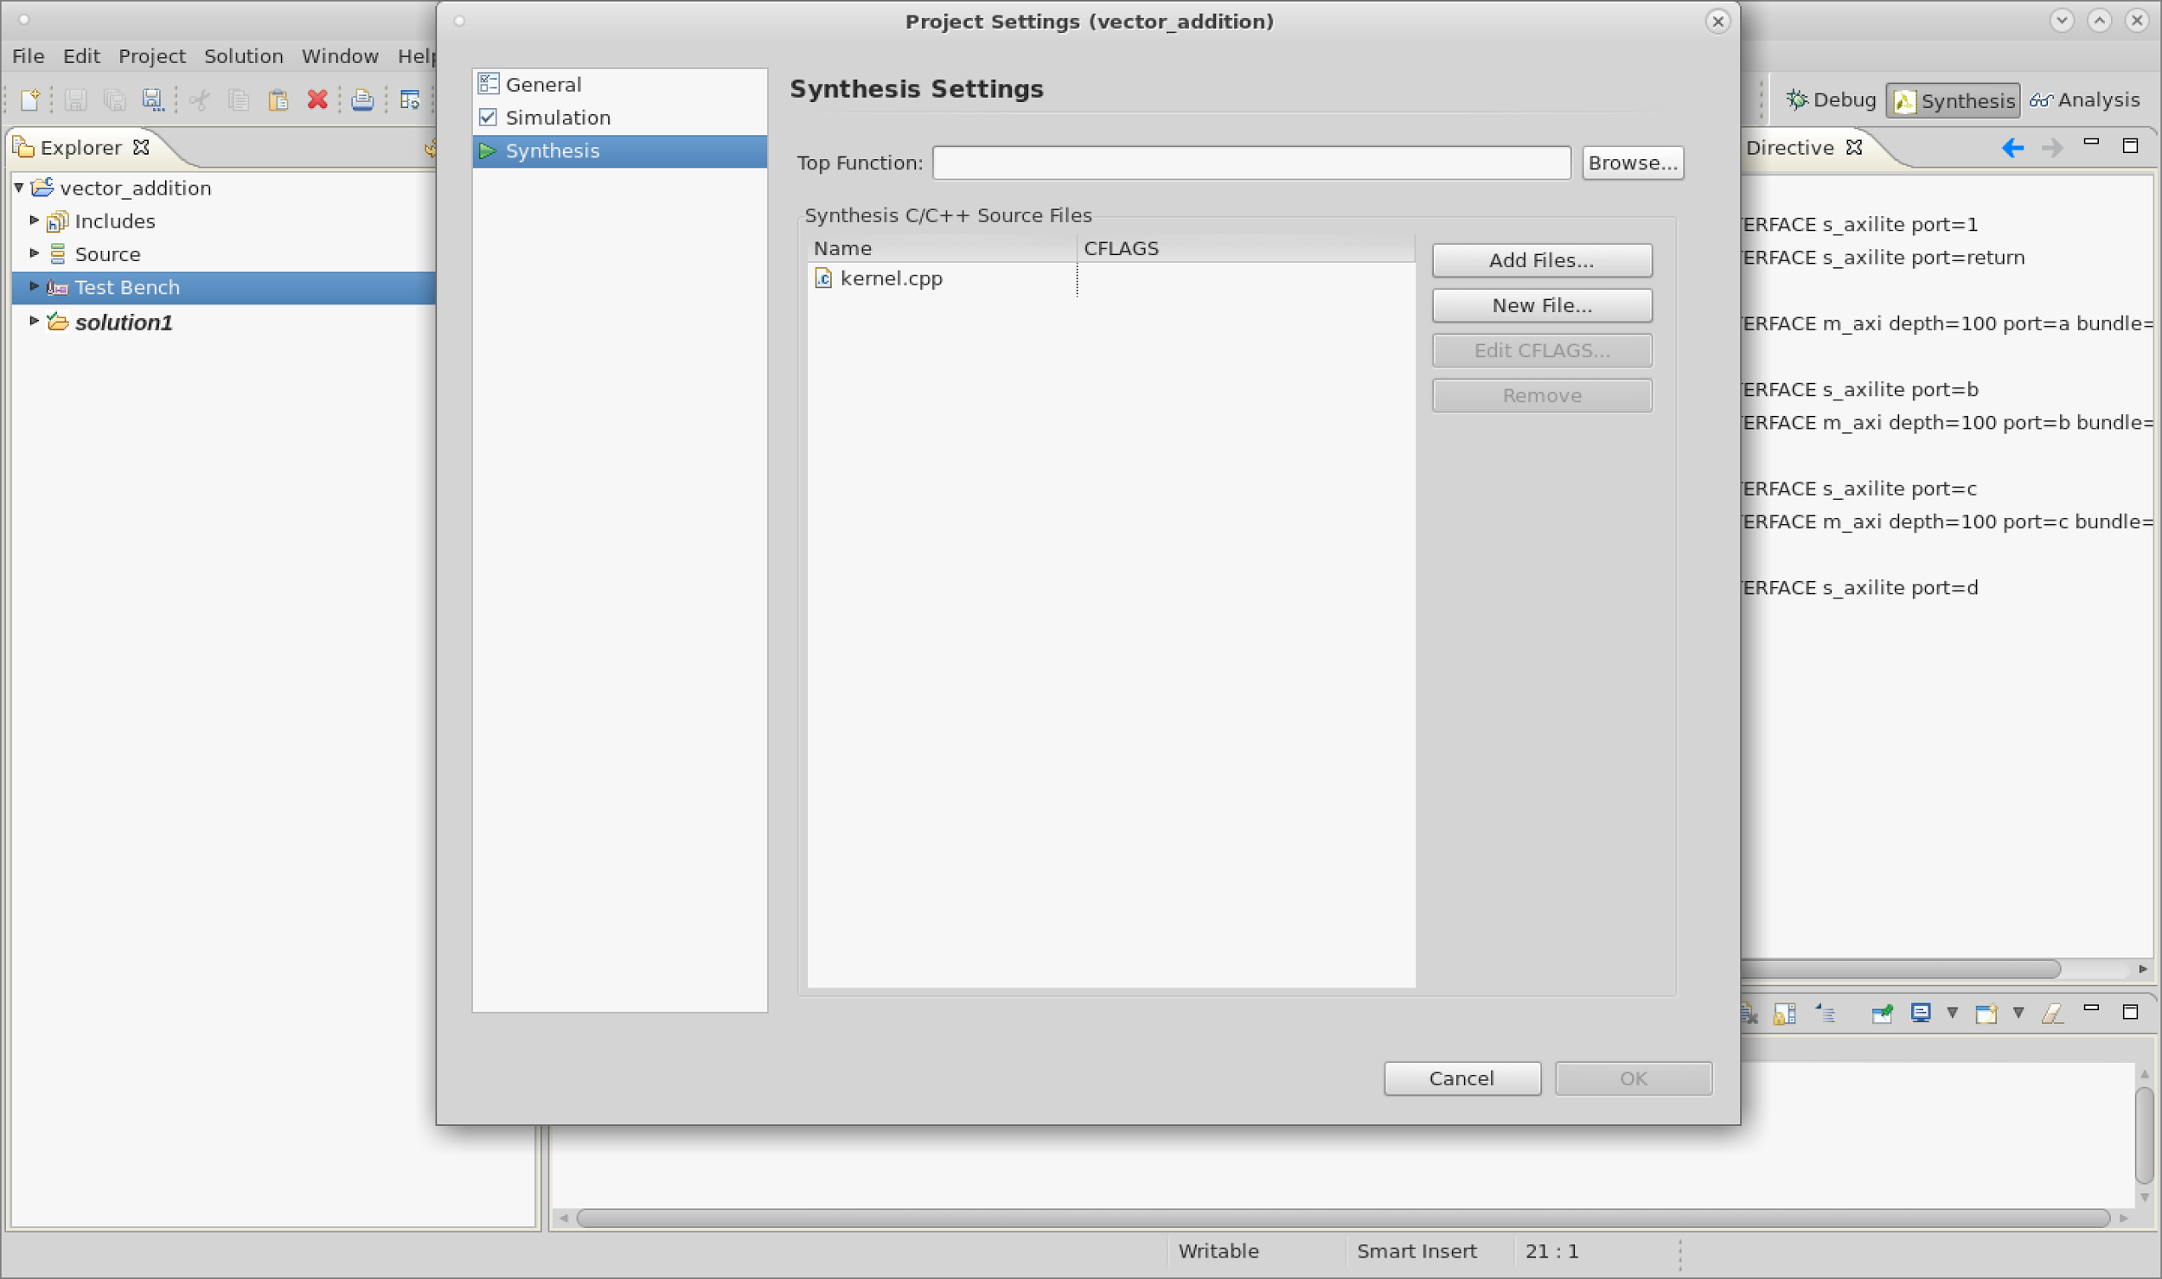
Top Function Selection
Text

Slide 52
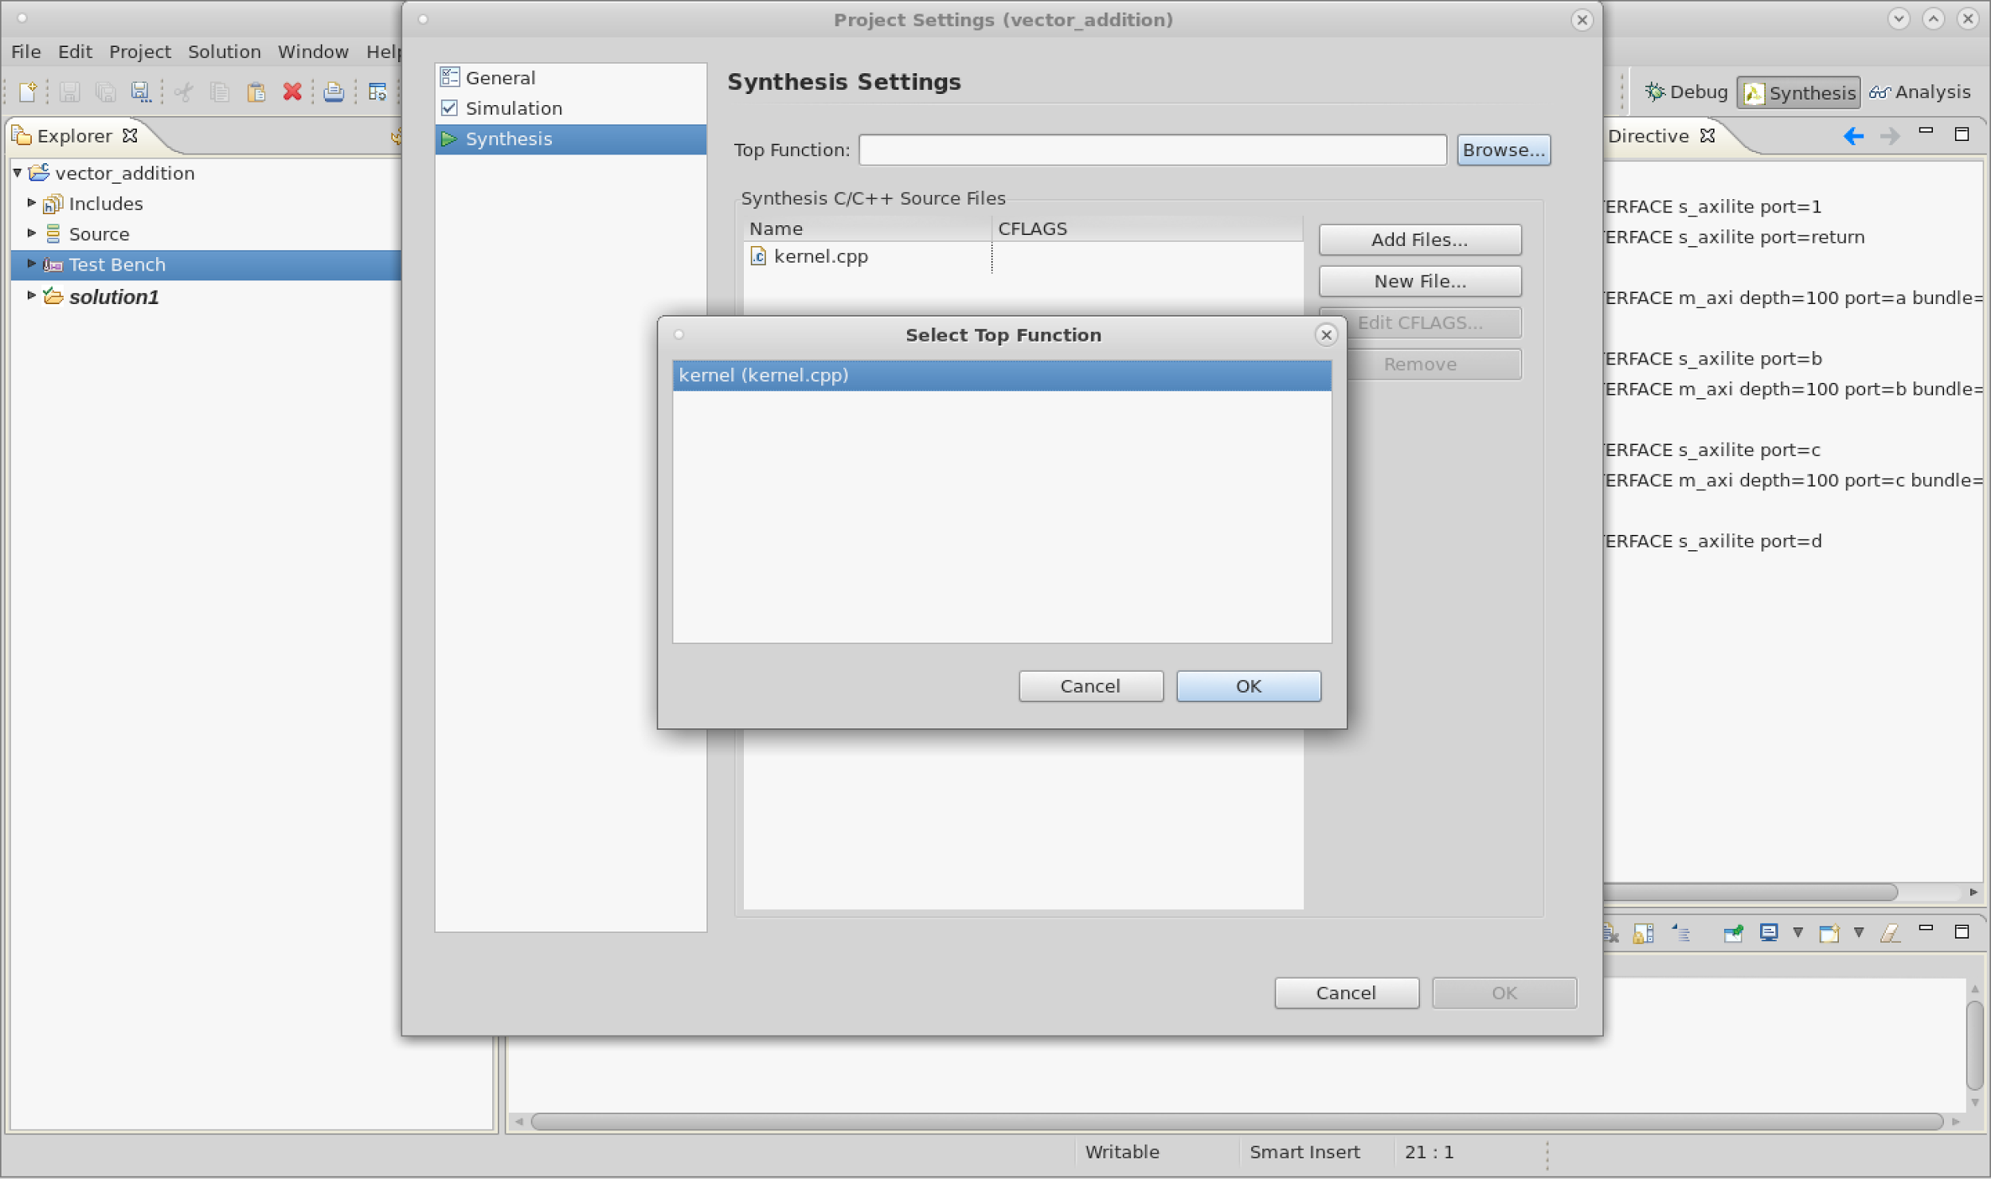
Top Function Selection
Text

Slide 53
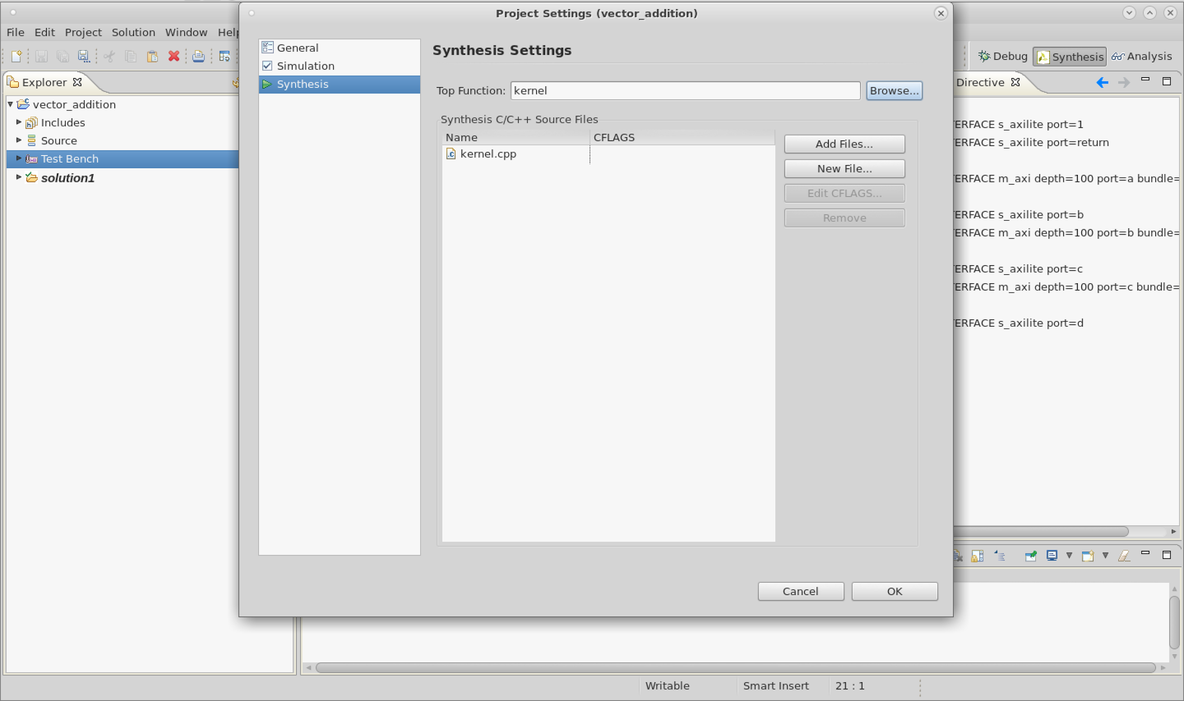
Top Function Selection
Text

Slide 54
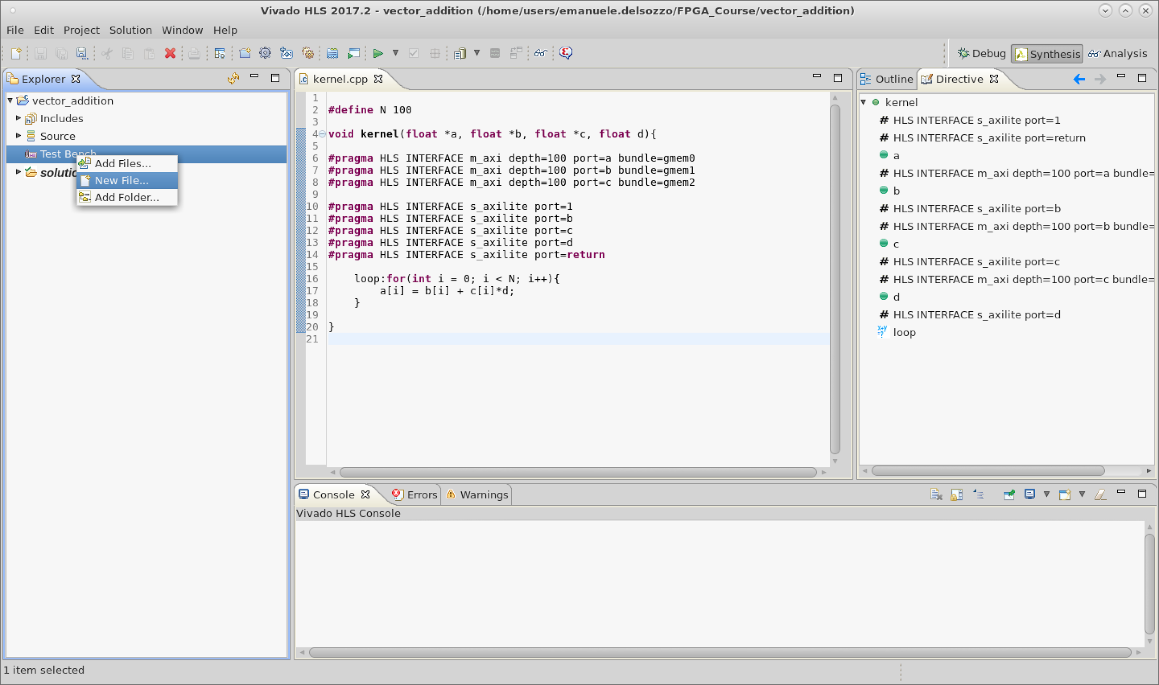
Testbench Creation
Text

Slide 55
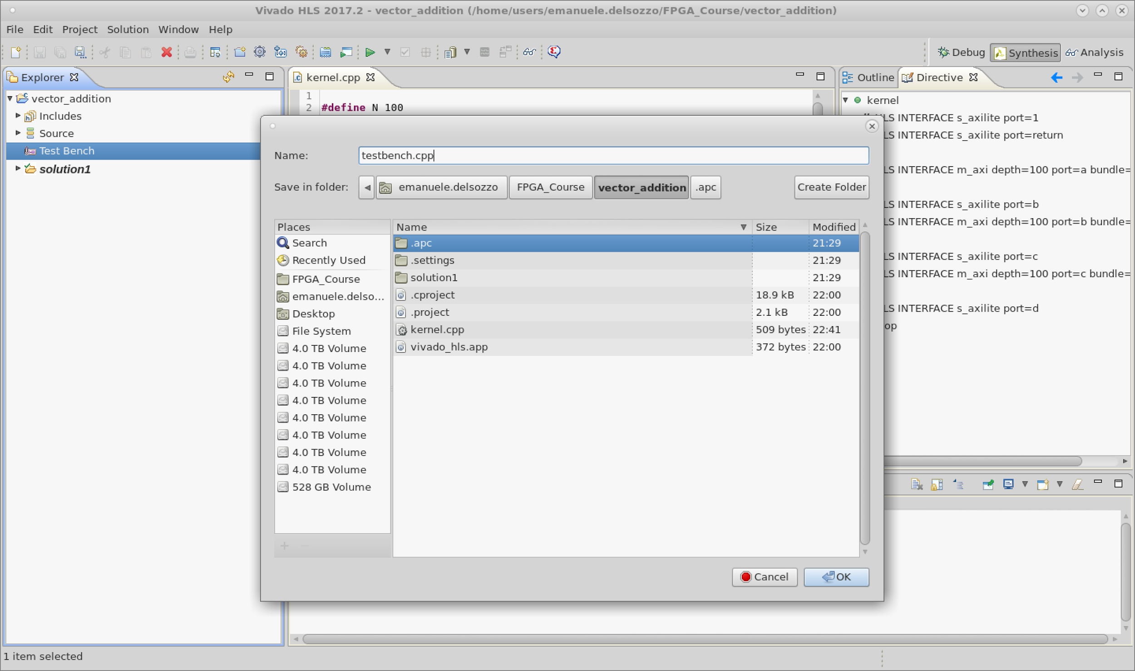
Testbench Creation
Text

Slide 56
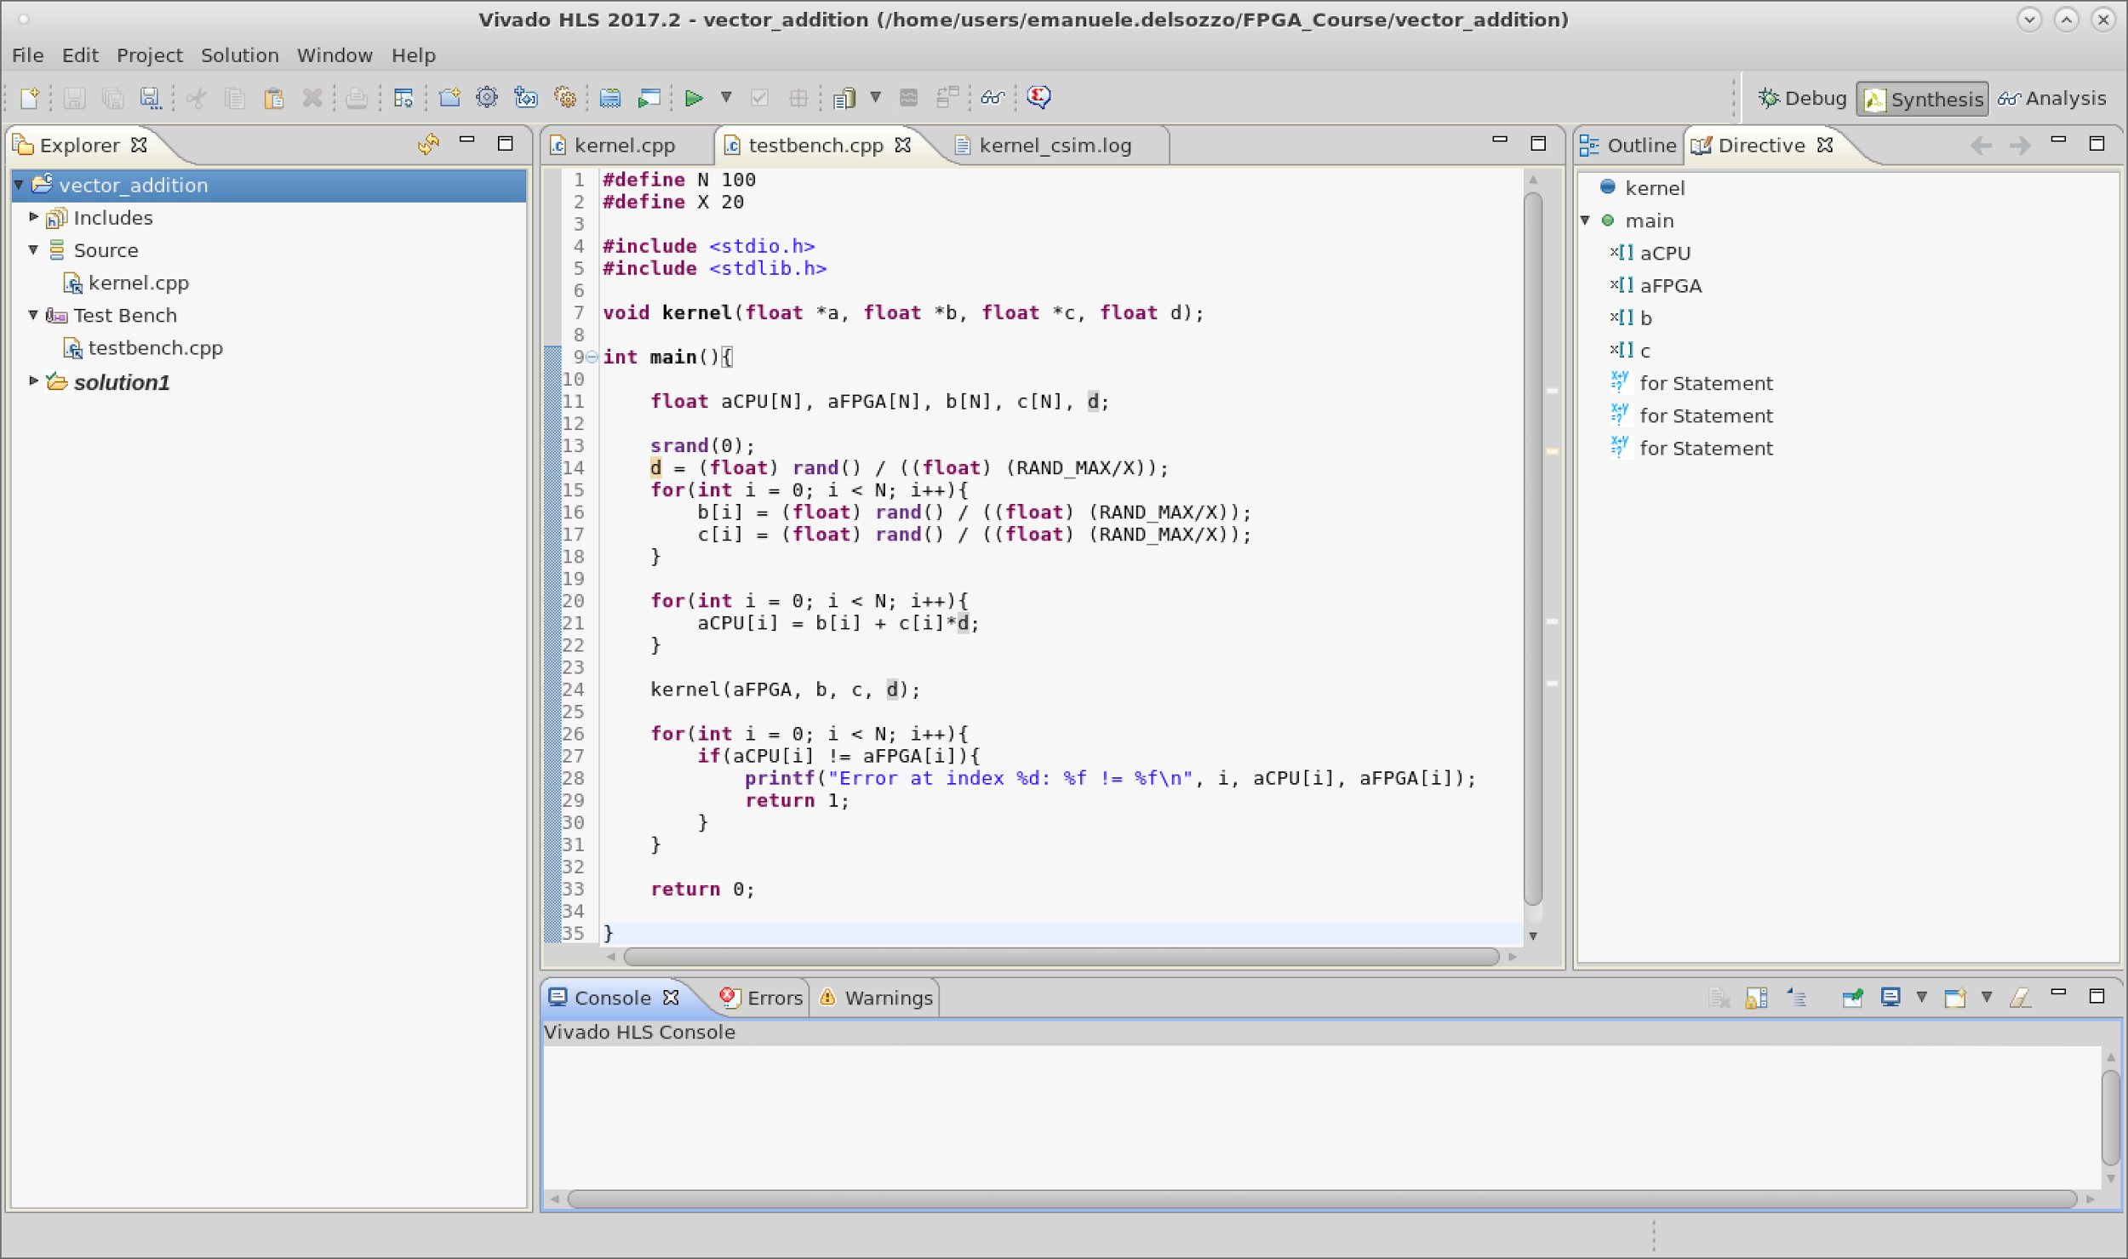
Testbench
Text

Slide 57
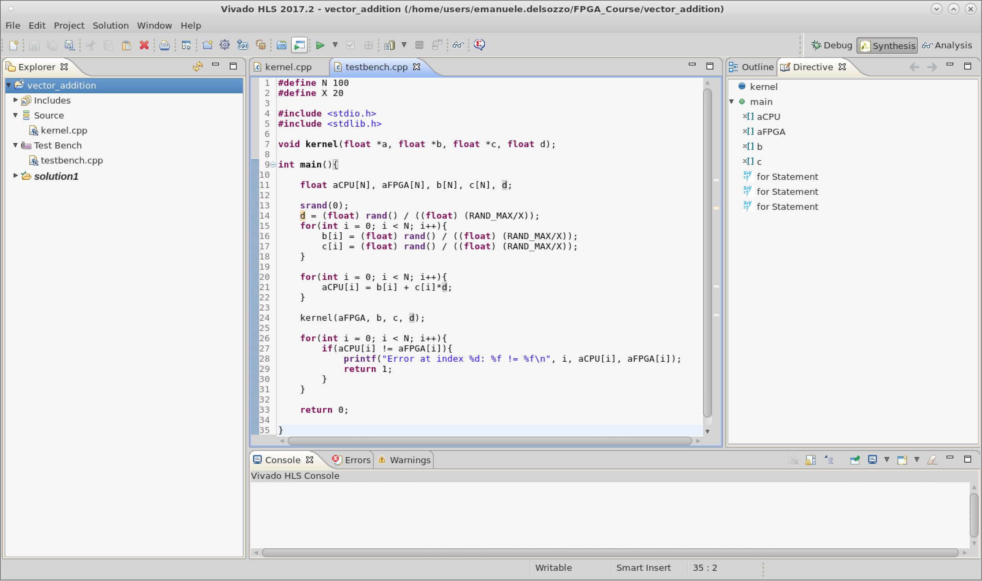
Run C Simulation
Text

Slide 58
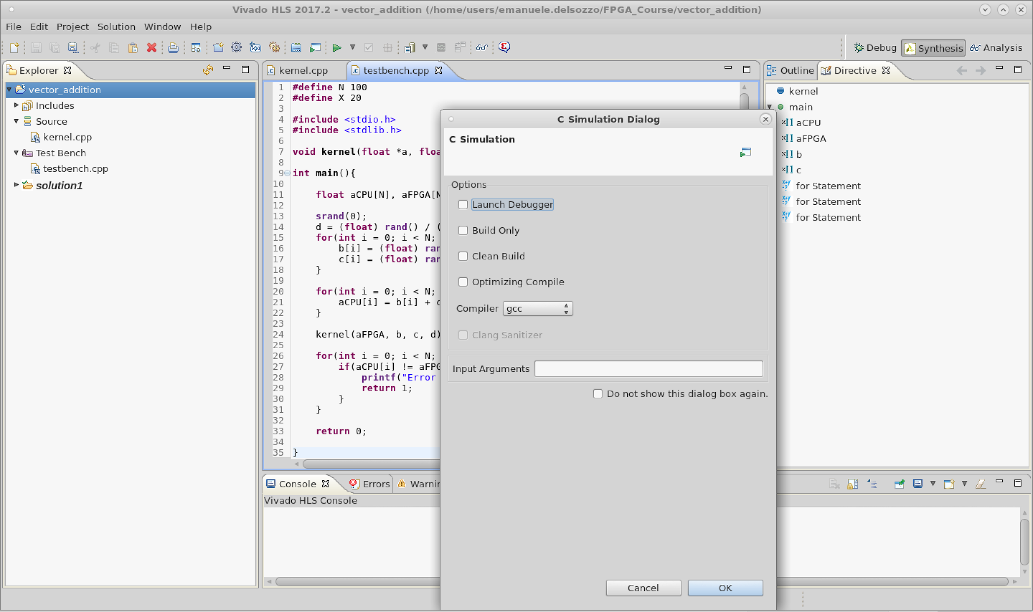
C Simulation Settings
Text

Slide 59
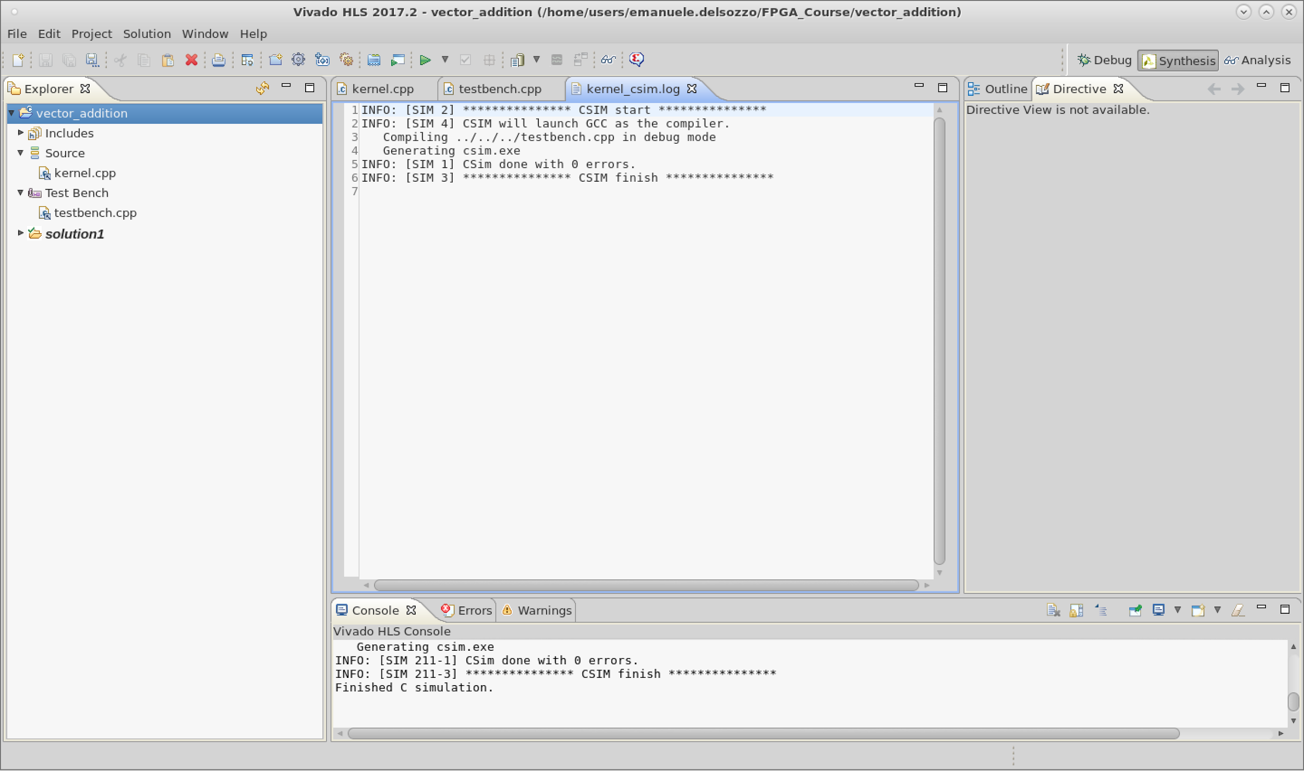
C Simulation Result
Text

Slide 60
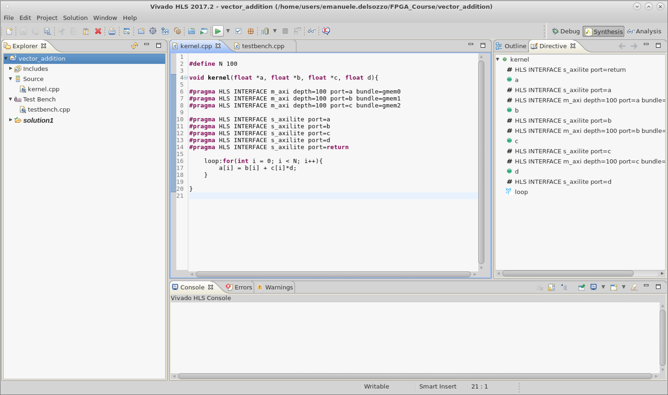
Run Synthesis
Text
Synthesis Log
Console

Slide 61
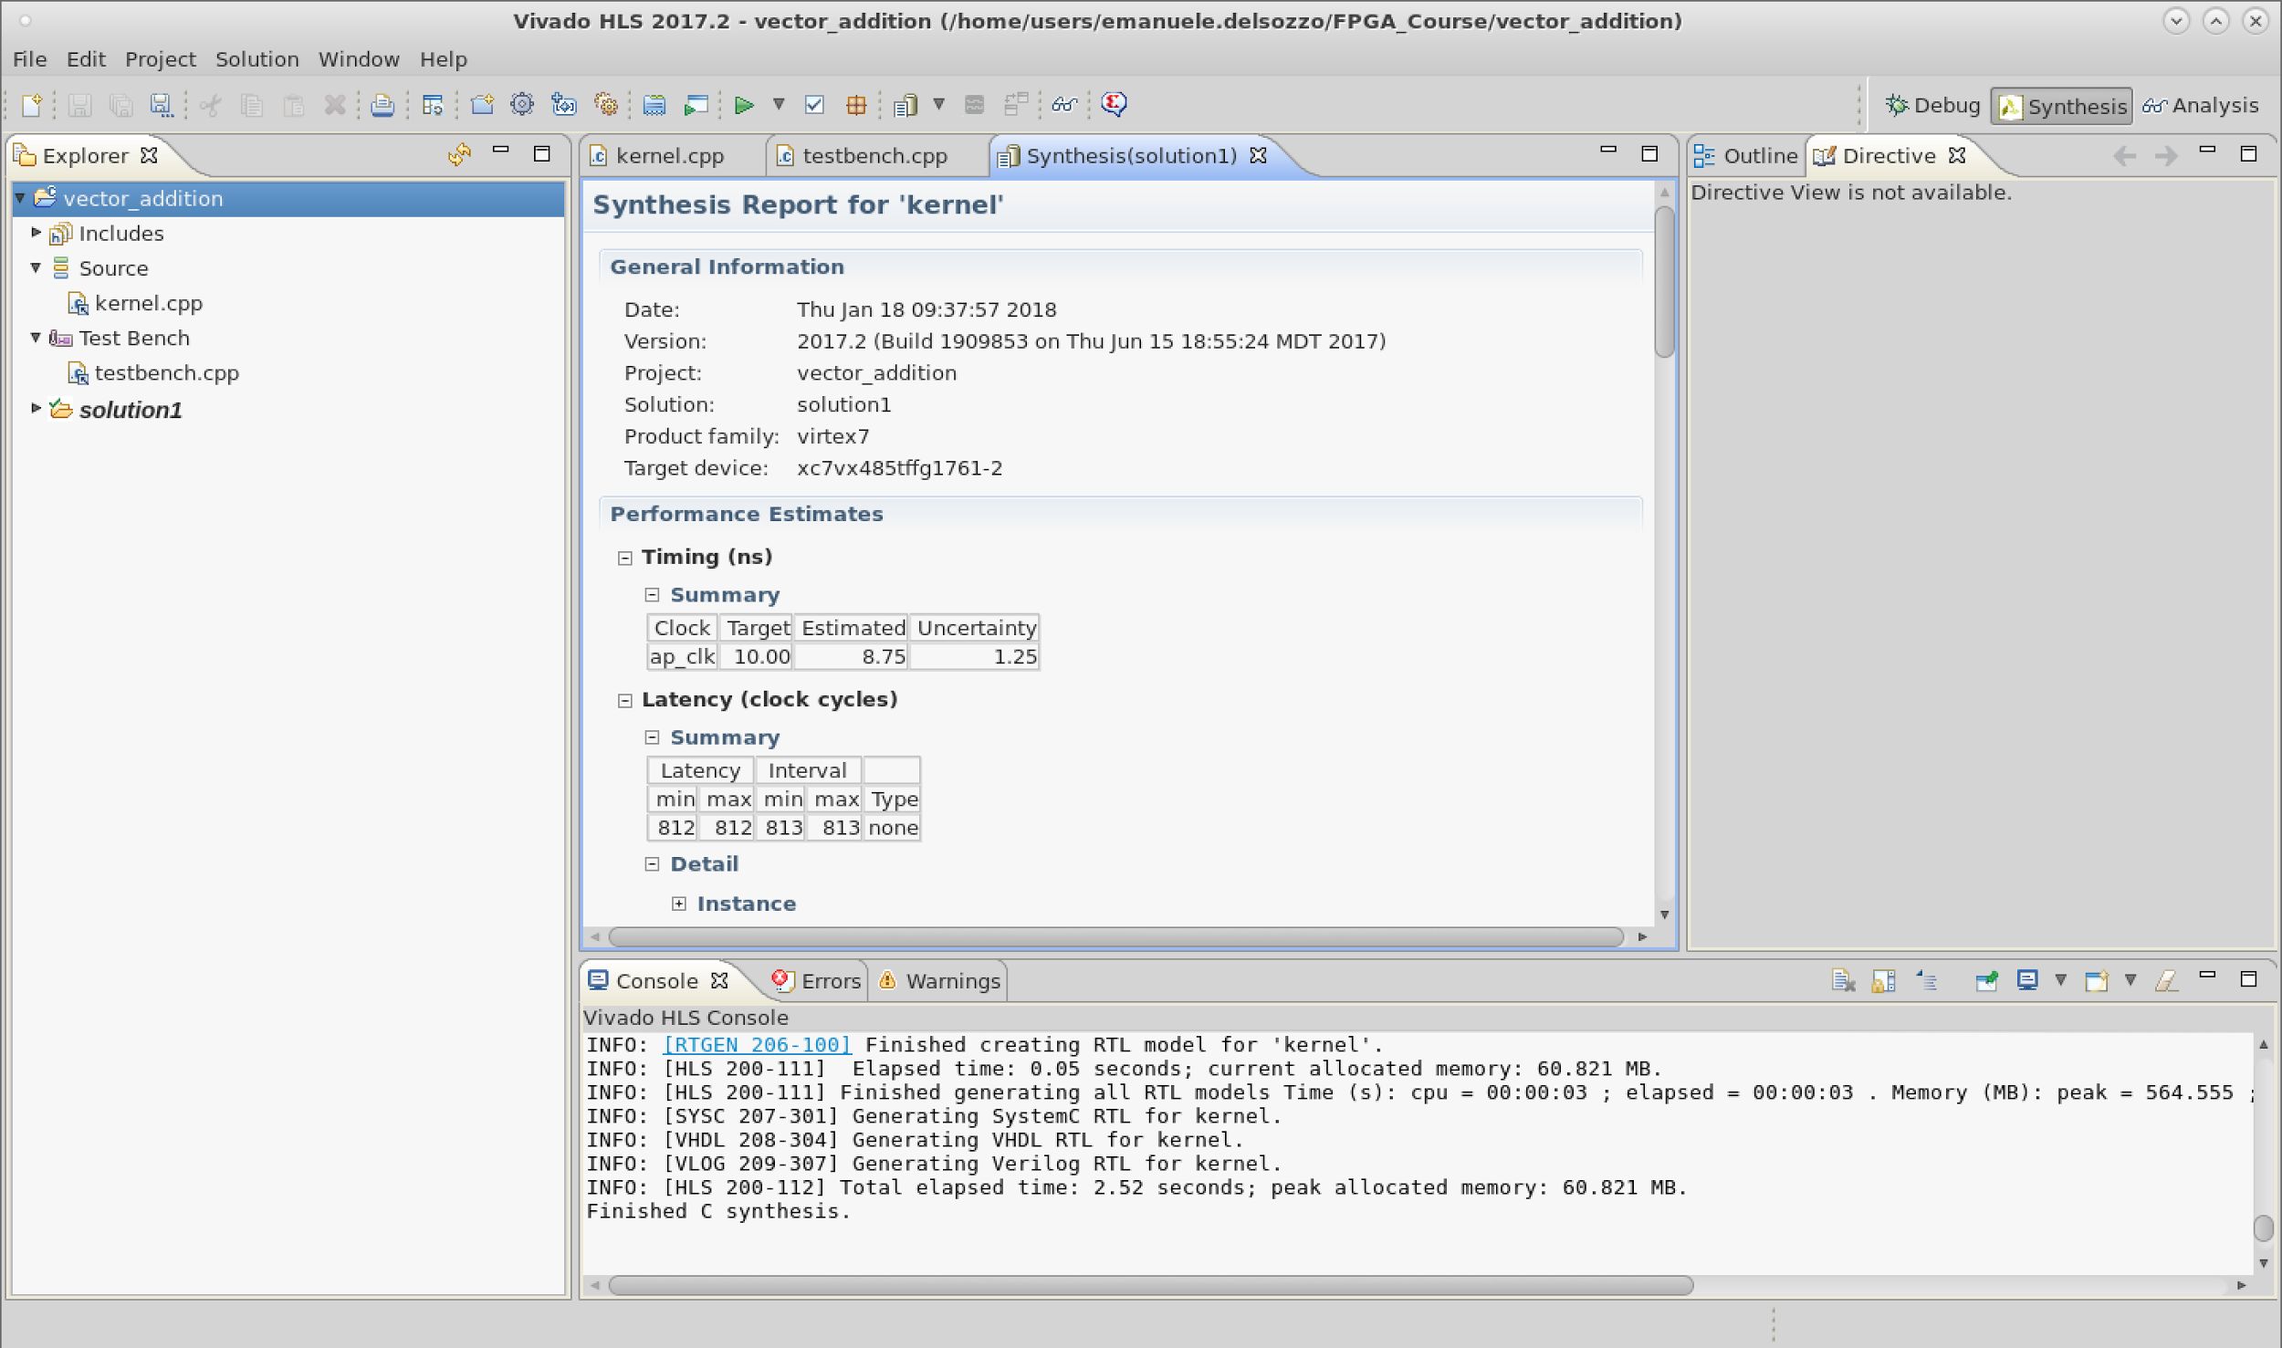
Synthesis Report
Text

Slide 62
Naive Implementation Report
Clock | Target | Estimated | Uncertainty
ap_clk | 10.00 | 8.75 | 1.25
Latency |  | Interval
min | max | min | max | Type
812 | 812 | 813 | 813 | none
Name | BRAM_18K | DSP48E | FF | LUT
Available | 2060 | 2800 | 2393 | 2618
Utilization | ~0% | ~0% | ~0% | ~0%

Slide 63

Run Co-Simulation
Text

Slide 64
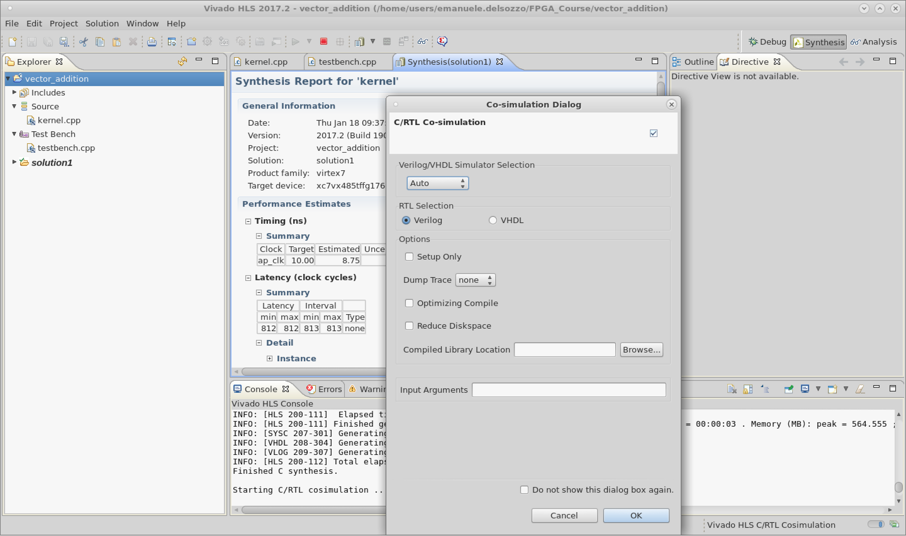
Co-Simulation Settings
Text

Slide 65
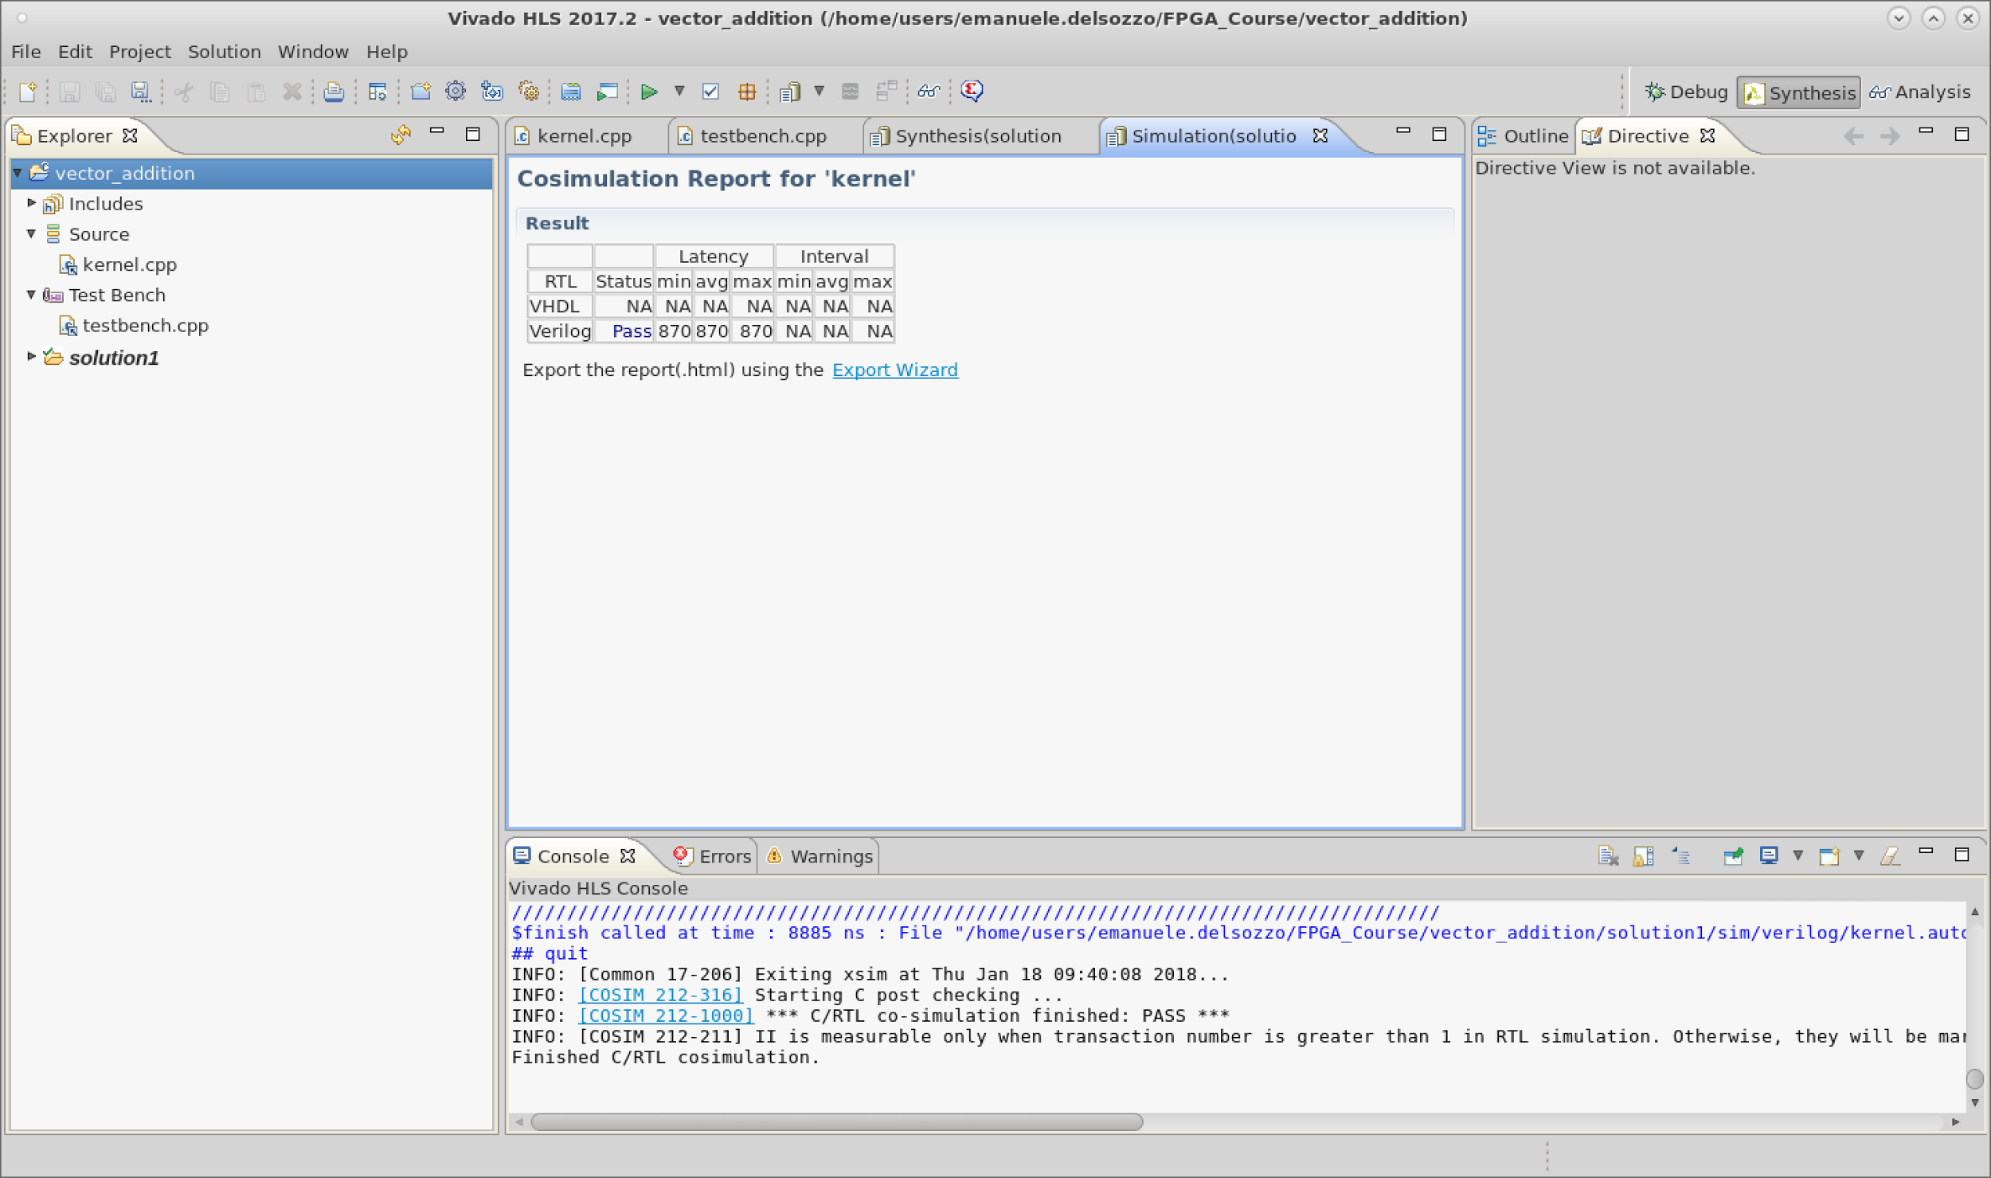
Co-Simulation Results
Text

Slide 66
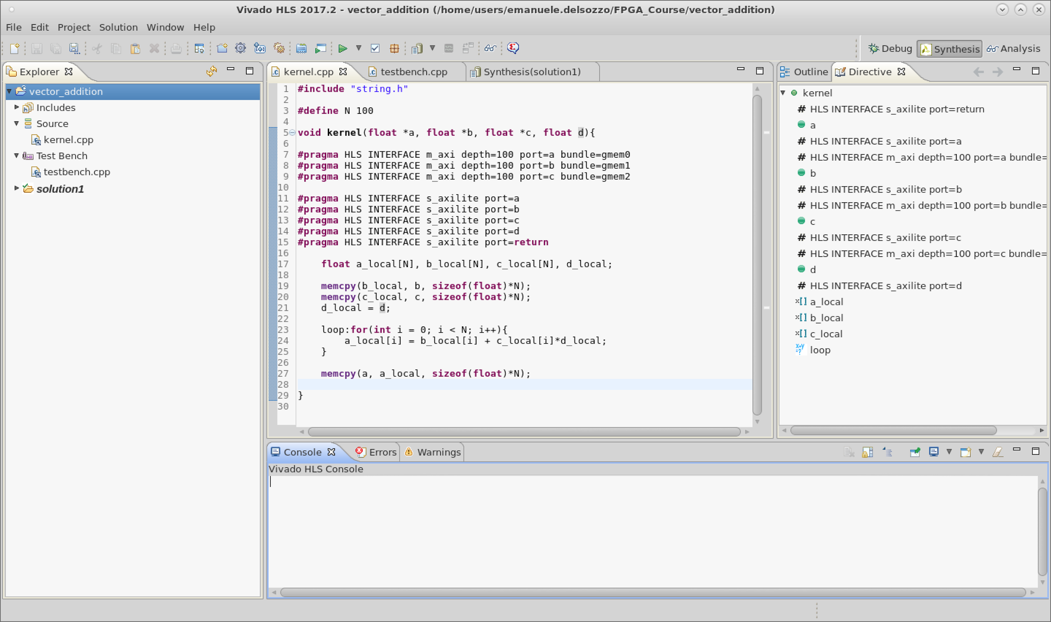
V1 Implementation
Text

Slide 67
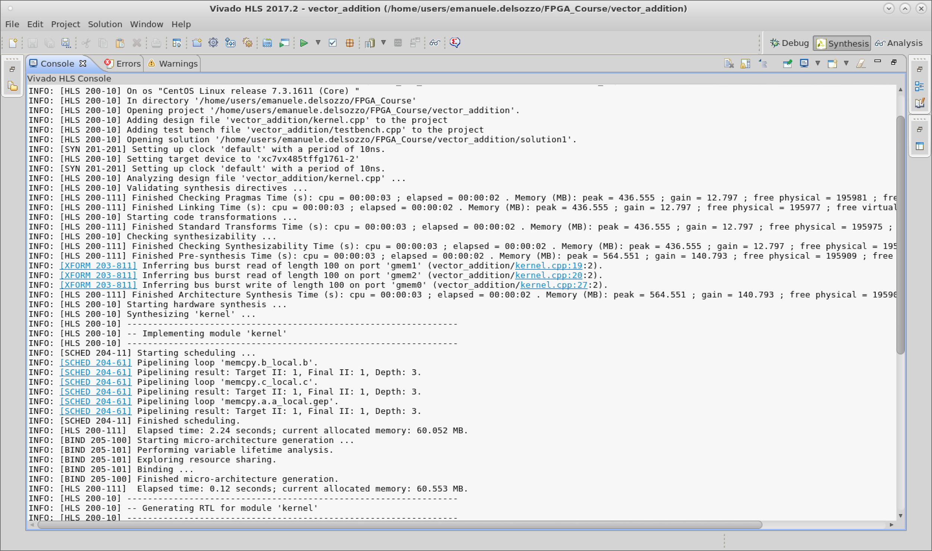
V1 Implementation Log
Text

Slide 68
V1 Implementation Report
Clock | Target | Estimated | Uncertainty
ap_clk | 10.00 | 8.75 | 1.25
Latency |  | Interval
min | max | min | max | Type
1227 | 1227 | 1228 | 1228 | none
Name | BRAM_18K | DSP48E | FF | LUT
Available | 2060 | 2800 | 2393 | 2618
Utilization | ~0% | ~0% | ~0% | ~0%

Slide 69
V1 Implementation Loops
 | Latency |  |  | Initiation Interval
Loop Name | min | max | Iteration Latency | achieved | target | Trip Count | Pipelined
memcpy b | 101 | 101 | 3 | 1 | 1 | 100 | yes
memcpy c | 101 | 101 | 3 | 1 | 1 | 100 | yes
loop | 900 | 900 | 9 | - | - | 100 | no
memcpy a | 101 | 101 | 3 | 1 | 1 | 100 | yes

Slide 70
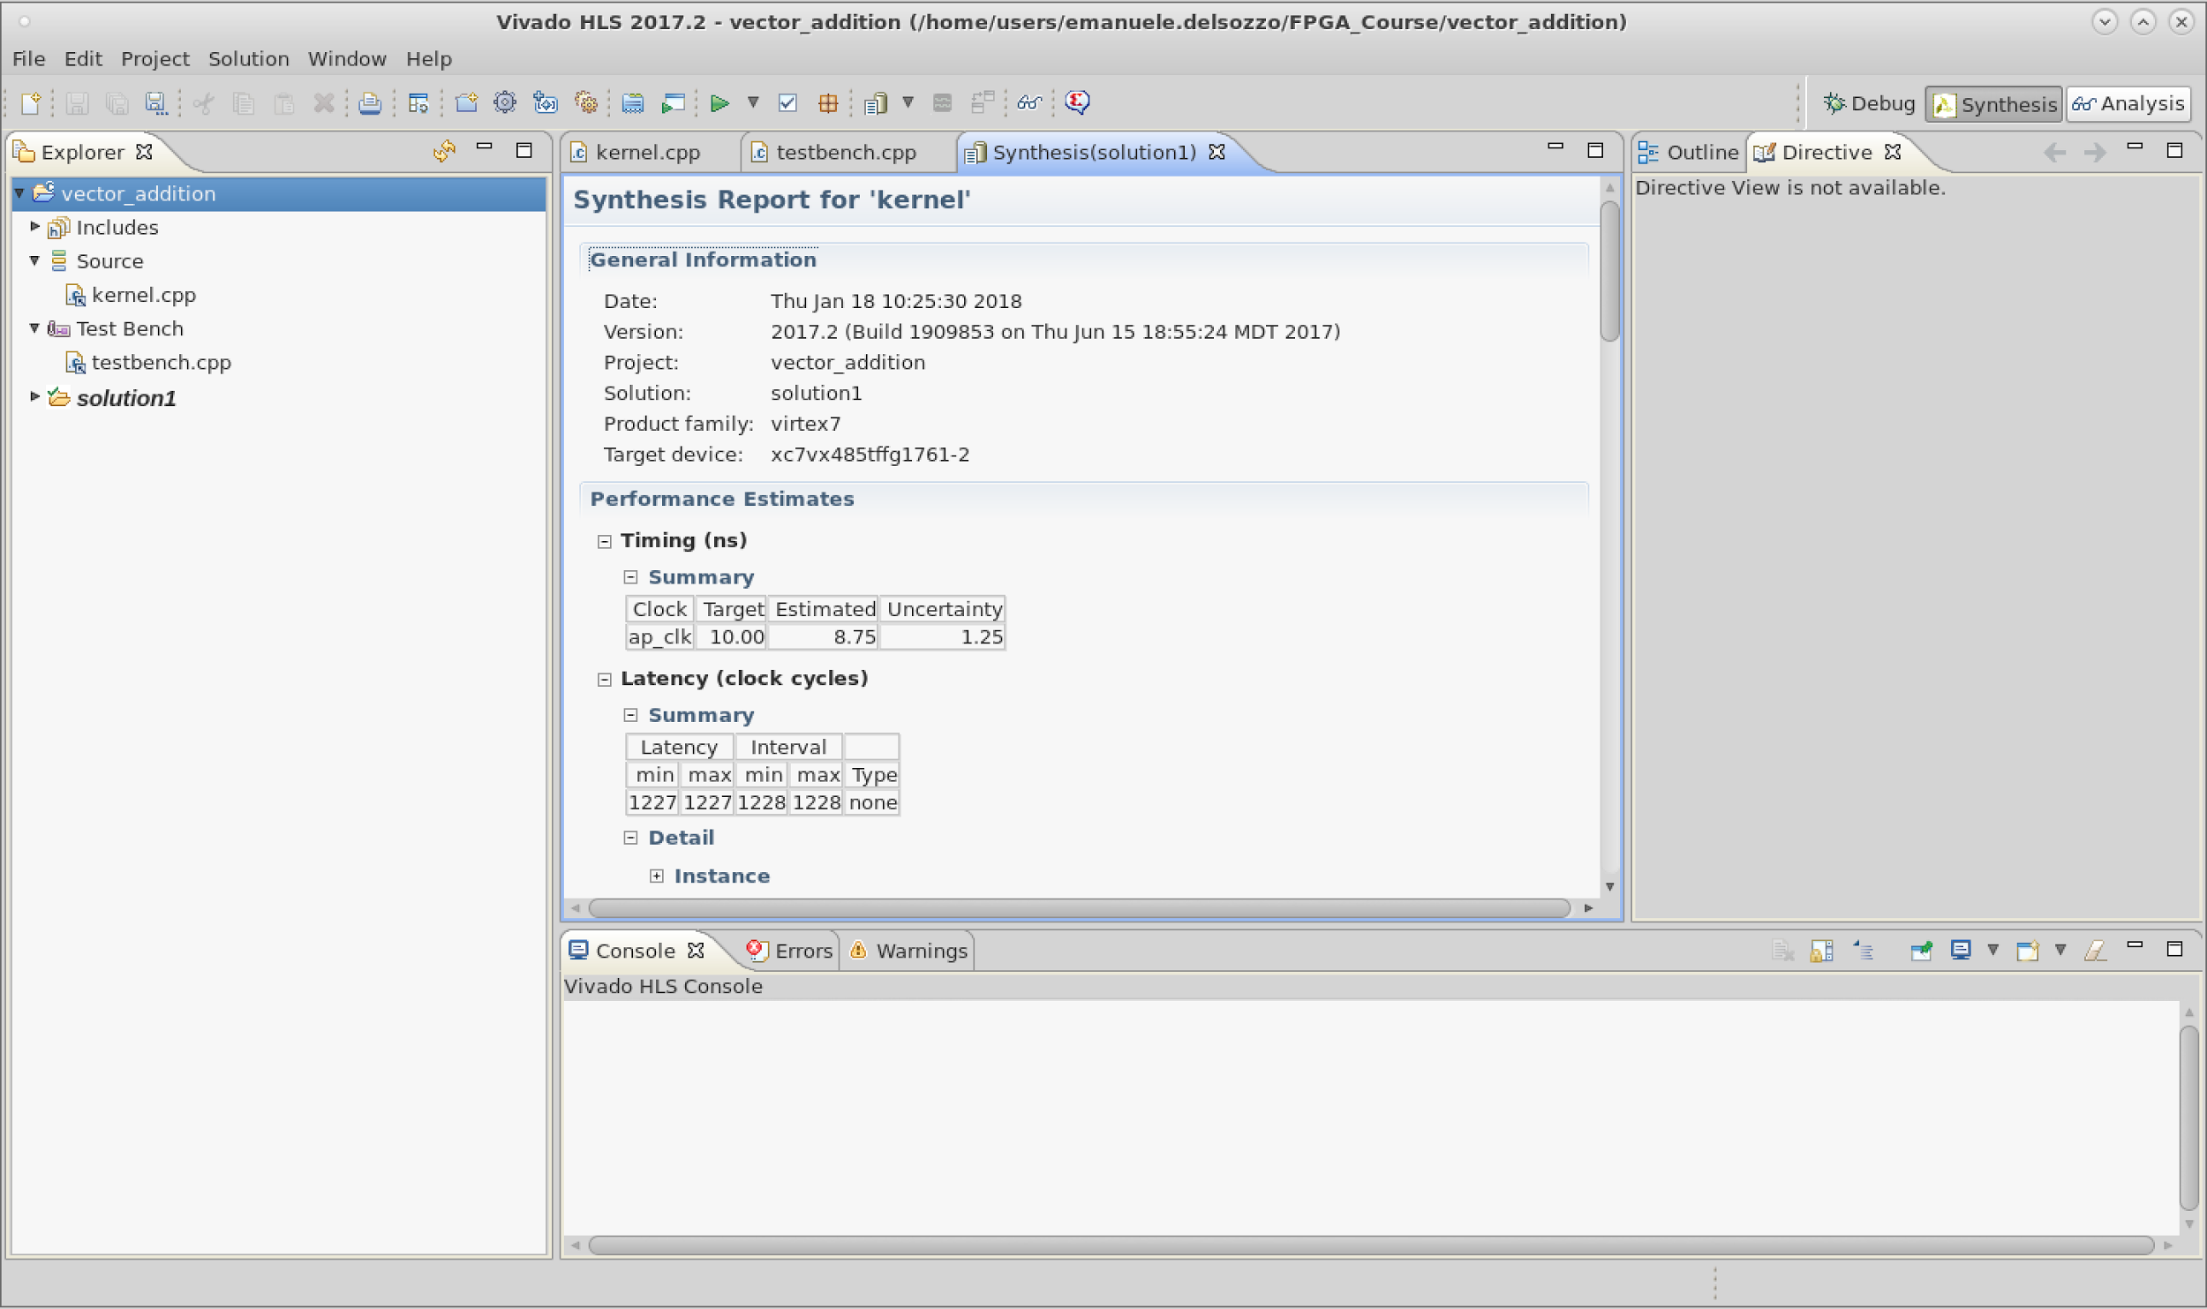
V1 Analysis
Text

Slide 71
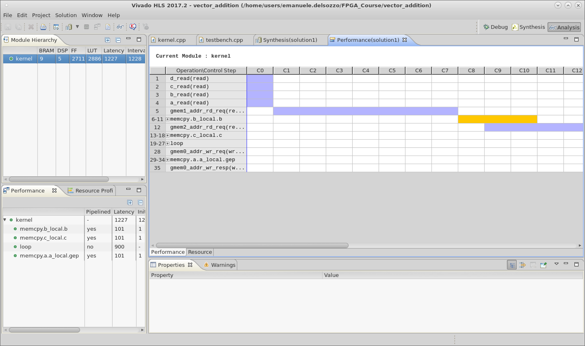
V1 Analysis
Text

Slide 72
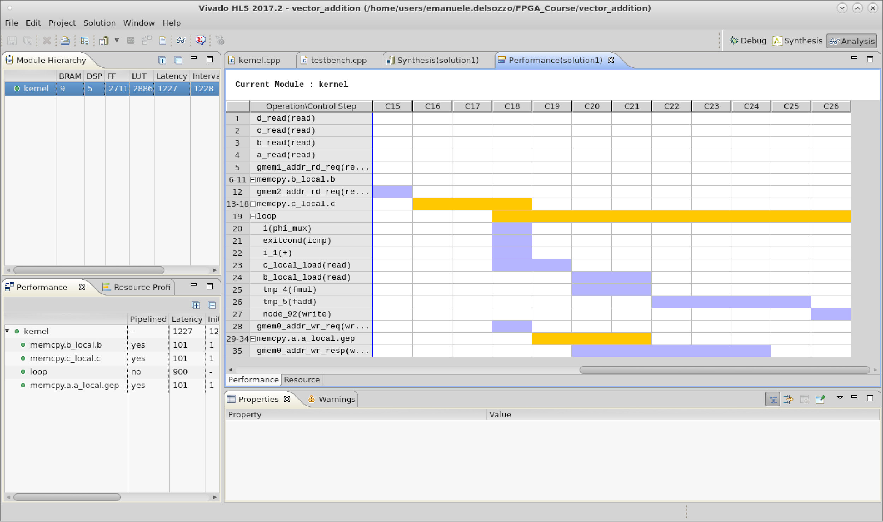
V1 Analysis
Text

Slide 73

V2 Implementation
Text

Slide 74

V2 Implementation Log
Text

Slide 75
V2 Implementation Report
Clock | Target | Estimated | Uncertainty
ap_clk | 10.00 | 8.75 | 1.25
Latency |  | Interval
min | max | min | max | Type
435 | 435 | 436 | 436 | none
Name | BRAM_18K | DSP48E | FF | LUT
Available | 2060 | 2800 | 2393 | 2618
Utilization | ~0% | ~0% | ~0% | ~0%

Slide 76
V2 Implementation Loops
 | Latency |  |  | Initiation Interval
Loop Name | min | max | Iteration Latency | achieved | target | Trip Count | Pipelined
memcpy b | 101 | 101 | 3 | 1 | 1 | 100 | yes
memcpy c | 101 | 101 | 3 | 1 | 1 | 100 | yes
loop | 107 | 107 | 9 | 1 | 1 | 100 | yes
memcpy a | 101 | 101 | 3 | 1 | 1 | 100 | yes

Slide 77

V3 Implementation
Text

Slide 78
V3 Implementation Report
Clock | Target | Estimated | Uncertainty
ap_clk | 10.00 | 8.75 | 1.25
Latency |  | Interval
min | max | min | max | Type
326 | 326 | 327 | 327 | none
Name | BRAM_18K | DSP48E | FF | LUT
Available | 2060 | 2800 | 2393 | 2618
Utilization | ~0% | ~0% | ~0% | ~0%

Slide 79
V3 Implementation Loops
 | Latency |  | Initiation Interval
Module | min | max | min | max | Type
myMemcpy | 109 | 109 | 109 | 109 | None
myMemcpy | 109 | 109 | 109 | 109 | None
 | Latency |  |  | Initiation Interval
Loop Name | min | max | Iteration Latency | achieved | target | Trip Count | Pipelined
loop | 107 | 107 | 9 | 1 | 1 | 100 | yes
memcpy a | 101 | 101 | 3 | 1 | 1 | 100 | yes

Slide 80

V3 Implementation Analysis
Text
However, our board has only one physical memory port, hence it cannot physically transfer data in parallel

Slide 81


V4 Implementation
Text

Slide 82
V4 Implementation Report
Clock | Target | Estimated | Uncertainty
ap_clk | 10.00 | 8.75 | 1.25
Latency |  | Interval
min | max | min | max | Type
373 | 373 | 374 | 374 | none
Name | BRAM_18K | DSP48E | FF | LUT
Available | 2060 | 2800 | 2393 | 2618
Utilization | ~0% | ~0% | ~0% | 1%

Slide 83
V4 Implementation Loops
 | Latency |  |  | Initiation Interval
Loop Name | min | max | Iteration Latency | achieved | target | Trip Count | Pipelined
memcpy b | 101 | 101 | 3 | 1 | 1 | 100 | yes
memcpy c | 101 | 101 | 3 | 1 | 1 | 100 | yes
memcpy a | 101 | 101 | 3 | 1 | 1 | 100 | yes

Slide 84

V4 Implementation Analysis
Text

Slide 85

Insert Directive for a_local
Text

Slide 86

Array Directives
Text

Slide 87

Array Partition Directive
Text

Slide 88

Array a_local directive
Text

Slide 89

V5 Implementation
Text

Slide 90
V5 Implementation Report
Clock | Target | Estimated | Uncertainty
ap_clk | 10.00 | 8.75 | 1.25
Latency |  | Interval
min | max | min | max | Type
320 | 320 | 321 | 321 | none
Name | BRAM_18K | DSP48E | FF | LUT
Available | 2060 | 2800 | 2393 | 2618
Utilization | ~0% | 17% | 8% | 12%

Slide 91
V5 Implementation Loops
 | Latency |  |  | Initiation Interval
Loop Name | min | max | Iteration Latency | achieved | target | Trip Count | Pipelined
memcpy b | 101 | 101 | 3 | 1 | 1 | 100 | yes
memcpy c | 101 | 101 | 3 | 1 | 1 | 100 | yes
memcpy a | 101 | 101 | 3 | 1 | 1 | 100 | yes

Slide 92

V5 Implementation Analysis
Text

Slide 93

V5* Implementation
Text

Slide 94
V5* Implementation Report
Clock | Target | Estimated | Uncertainty
ap_clk | 10.00 | 8.75 | 1.25
Latency |  | Interval
min | max | min | max | Type
508 | 508 | 509 | 509 | none
Name | BRAM_18K | DSP48E | FF | LUT
Available | 2060 | 2800 | 2393 | 2618
Utilization | ~0% | 28% | 13% | 19%

Slide 95
V5* Implementation Loops
 | Latency |  |  | Initiation Interval
Loop Name | min | max | Iteration Latency | achieved | target | Trip Count | Pipelined
memcpy b | 160 | 160 | 2 | 1 | 1 | 100 | yes
memcpy c | 160 | 160 | 2 | 1 | 1 | 100 | yes
memcpy a | 160 | 160 | 2 | 1 | 1 | 100 | yes

Slide 96

V6 Implementation
Text

Slide 97
V6 Implementation Report
Clock | Target | Estimated | Uncertainty
ap_clk | 10.00 | 8.75 | 1.25
Latency |  | Interval
min | max | min | max | Type
75 | 75 | 76 | 76 | none
Name | BRAM_18K | DSP48E | FF | LUT
Available | 2060 | 2800 | 2393 | 2618
Utilization | 6% | 2% | 2% | 3%

Slide 98
V6 Implementation Loops
 | Latency |  |  | Initiation Interval
Loop Name | min | max | Iteration Latency | achieved | target | Trip Count | Pipelined
memcpy b | 11 | 11 | 3 | 1 | 1 | 10 | yes
memcpy c | 11 | 11 | 3 | 1 | 1 | 10 | yes
loop1 | 17 | 17 | 9 | 1 | 1 | 10 | yes
memcpy a | 11 | 11 | 3 | 1 | 1 | 10 | yes

Slide 99

V7 Implementation
Text

Slide 100

Streaming Interface
Text

Slide 101

V7 Testbench
Text

Slide 102
V7 Implementation Report
Clock | Target | Estimated | Uncertainty
ap_clk | 10.00 | 8.46 | 1.25
Latency |  | Interval
min | max | min | max | Type
169 | 169 | 170 | 170 | none
Name | BRAM_18K | DSP48E | FF | LUT
Available | 2060 | 2800 | 2393 | 2618
Utilization | 0% | ~0% | ~0% | ~0%

Slide 103
V7 Implementation Loops
 | Latency |  |  | Initiation Interval
Loop Name | min | max | Iteration Latency | achieved | target | Trip Count | Pipelined
loop | 166 | 166 | 8 | 1 | 1 | 160 | yes

Slide 104

V8 Implementation
Text

Slide 105

V8 Streaming Interface
Text

Slide 106

V8 Testbench
Text

Slide 107
V8 Implementation Report
Clock | Target | Estimated | Uncertainty
ap_clk | 10.00 | 8.46 | 1.25
Latency |  | Interval
min | max | min | max | Type
19 | 19 | 20 | 20 | none
Name | BRAM_18K | DSP48E | FF | LUT
Available | 2060 | 2800 | 2393 | 2618
Utilization | 0% | 2% | 1% | 1%

Slide 108
V8 Implementation Loops
 | Latency |  |  | Initiation Interval
Loop Name | min | max | Iteration Latency | achieved | target | Trip Count | Pipelined
loop | 16 | 16 | 8 | 1 | 1 | 10 | yes

Slide 109

Export IP

Slide 110

Export IP Settings

Slide 111

Export IP Done

Slide 112
This is only the beginning!!
For more information, read Vivado HLS manual
https://www.xilinx.com/support/documentation/sw_manuals/xilinx2017_2/ug902-vivado-high-level-synthesis.pdf

Slide 113

Feedbacks
We are working at improving this course, would you share your feedback for this lesson?
https://goo.gl/tLcWQj

Slide 114

Thank You for the Attention!
Lorenzo Di Tucci lorenzo.ditucci@polimi.it
Emanuele Del Sozzo emanuele.delsozzo@polimi.it
Marco D. Santambrogio marco.santambrogio@polimi.it

